Slide 1

Azure cloud i Windows Admin Center
- ima neka hibridna veza
Goran Žarinac
Senior IT architect
Image Enter d.o.o. Bjelovar

Slide 2
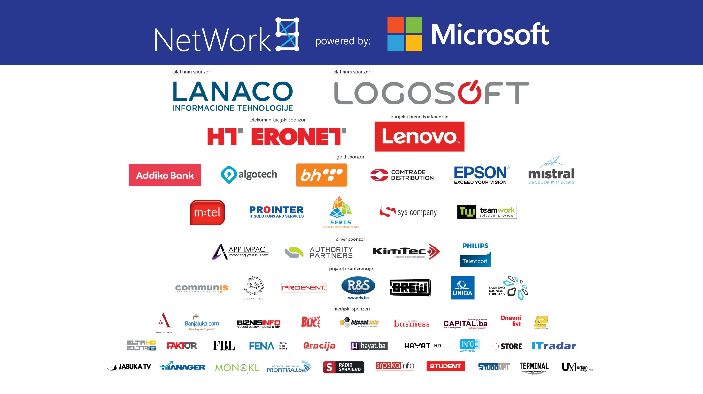

Slide 3

NetWork 9
Agenda
Windows Admin Centar – što, kako i zašto
Azure Active Directory authentication
Azure Network Adapter
Azure Backup
Azure Site Recovery
Azure VM management kroz Windows Admin Center
Azure Update Management

Slide 4


NetWork 9
Za one koji žele znati više…
http://bit.do/network9

Slide 5


Slide 6
Windows Admin Center
“Windows Admin Center is a new, locally-deployed, browser-based
management tool set that lets you manage your Windows Servers
and PC’s with no Azure or cloud dependency.”
“Flexible, customer-deployed browser-based management
with core tools for troubleshooting, configuration, and maintenance.”

Slide 7
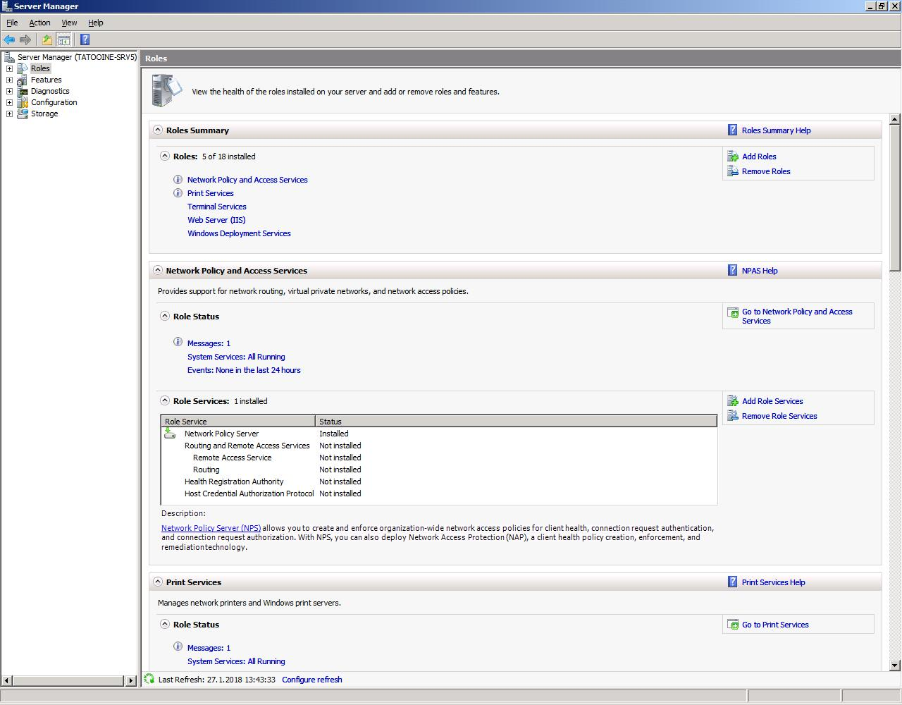
Windows Admin Center

Slide 8
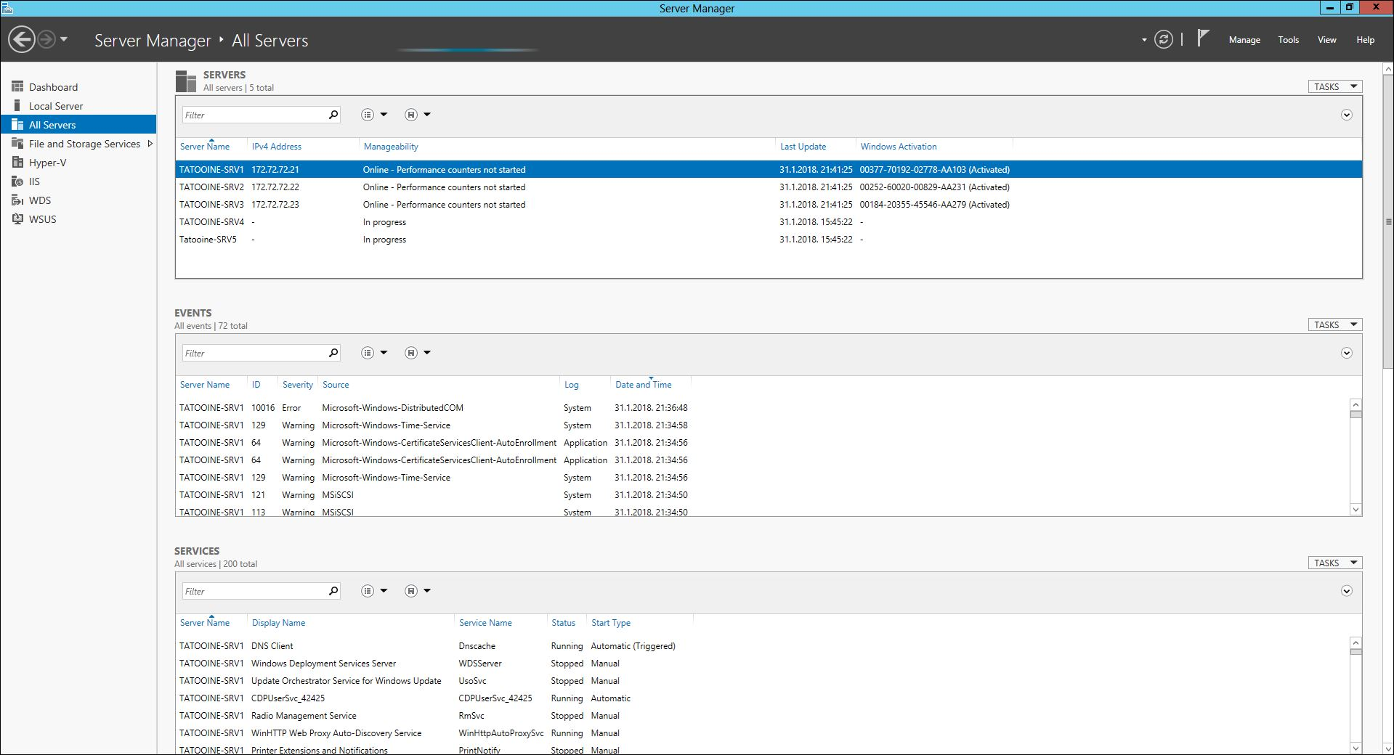
Windows Admin Center

Slide 9

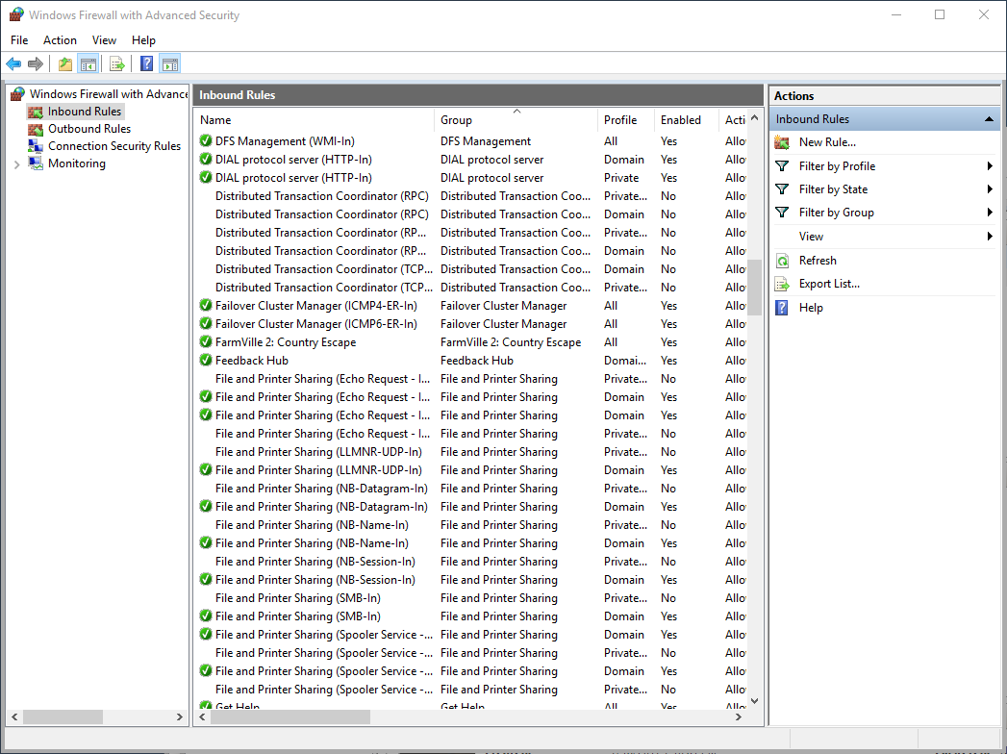
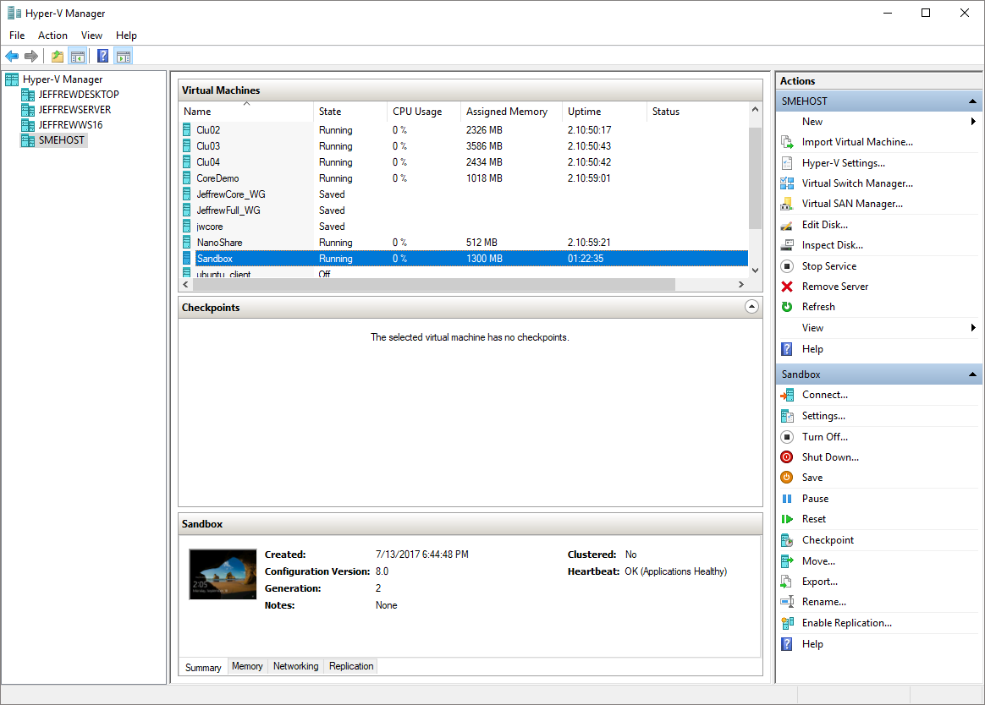
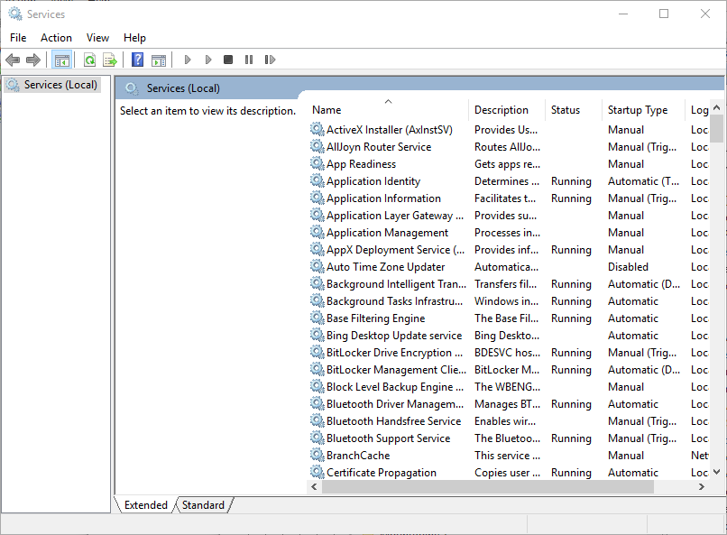
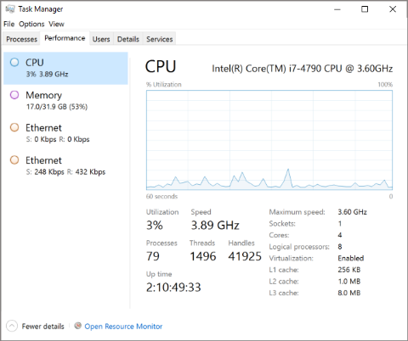
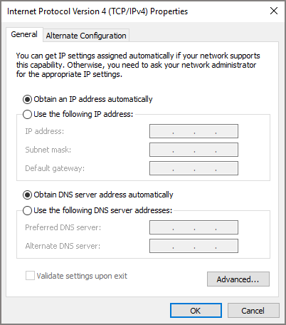
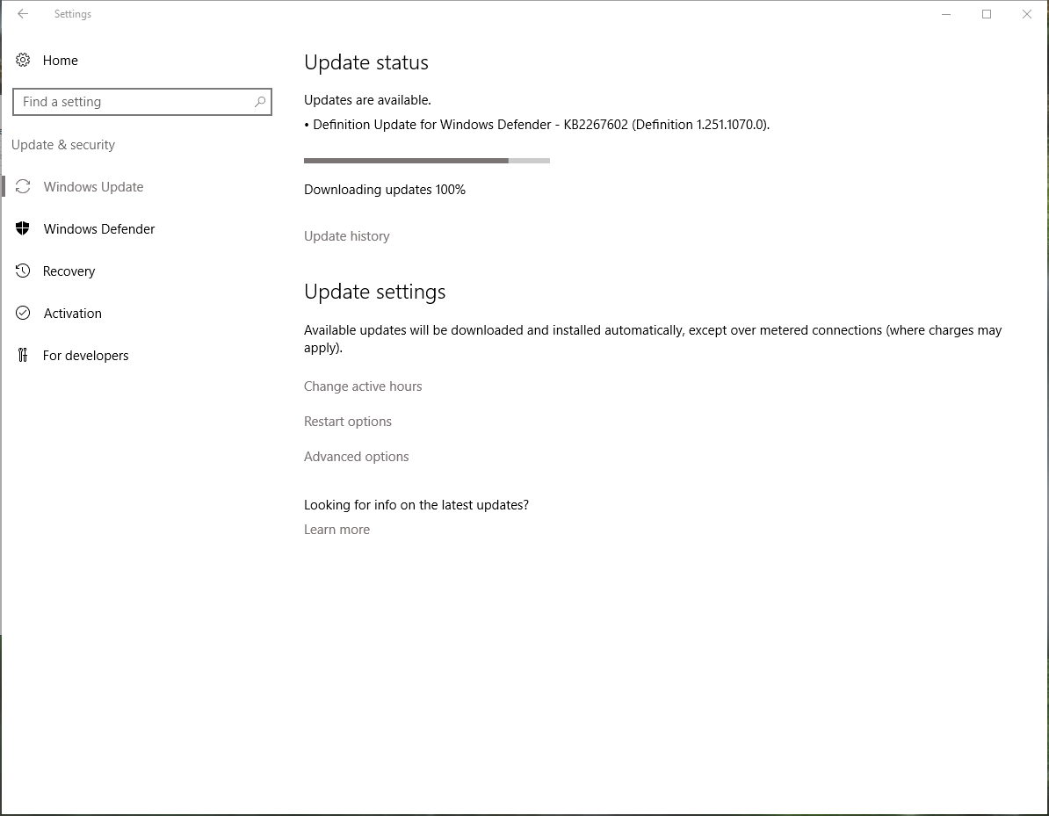
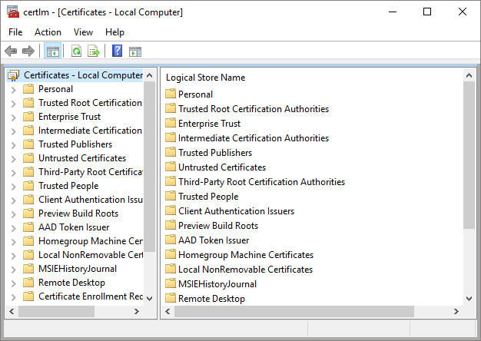
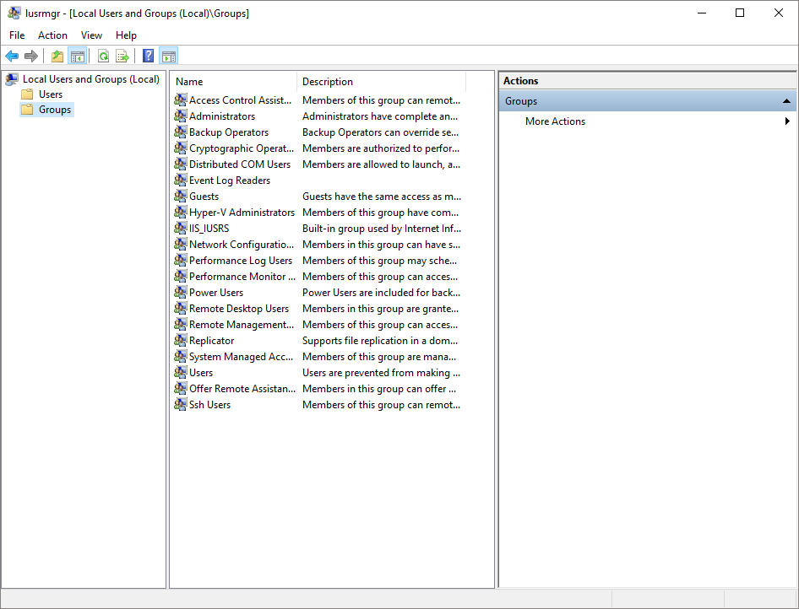
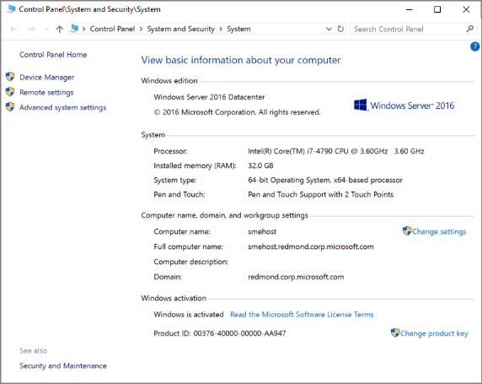
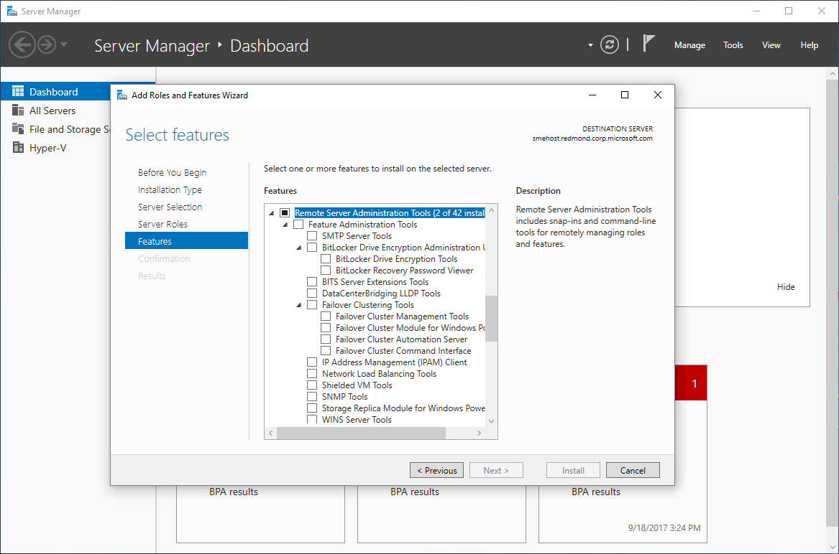
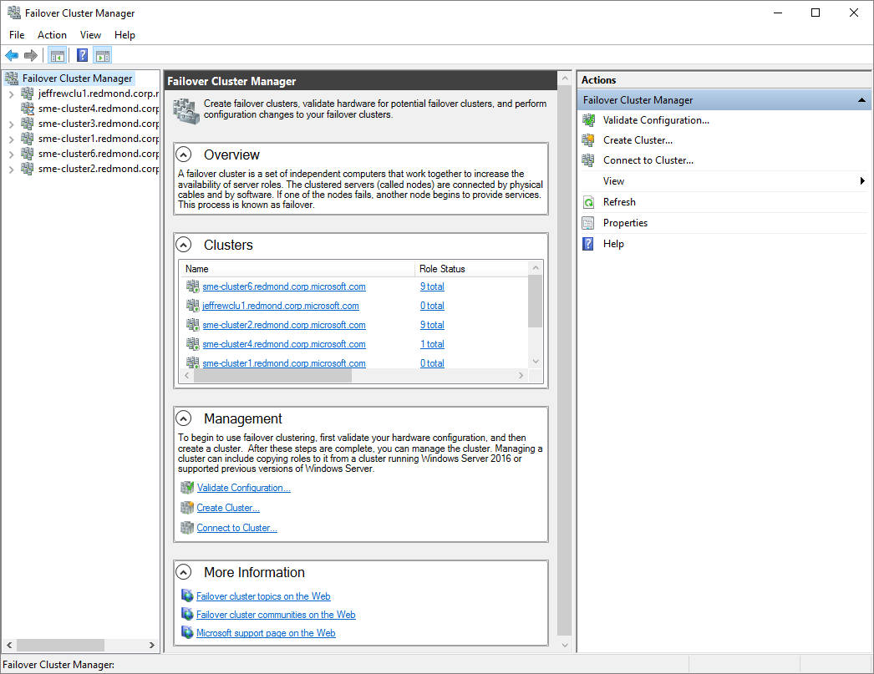
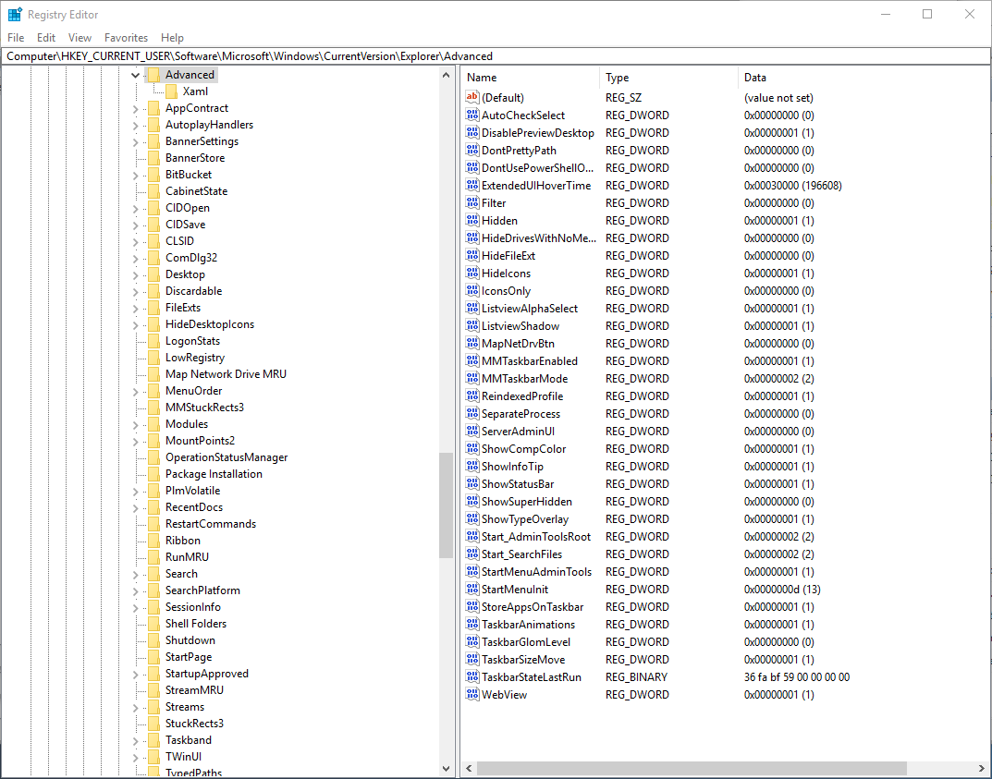
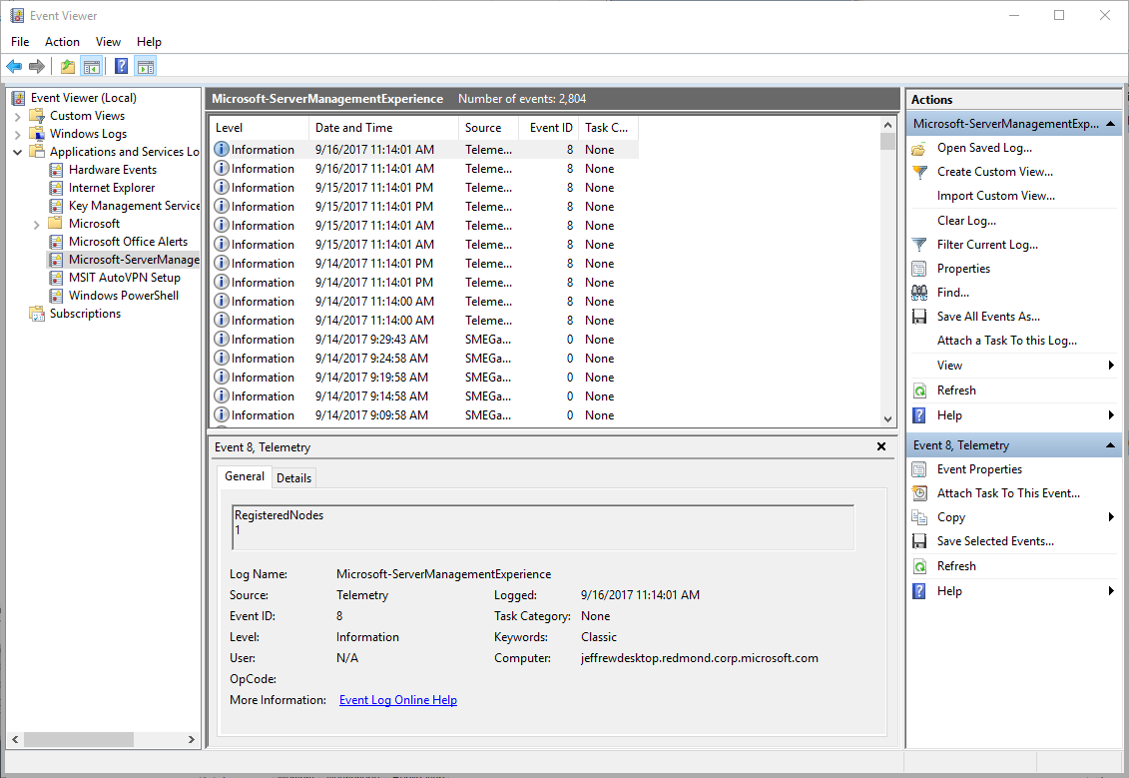
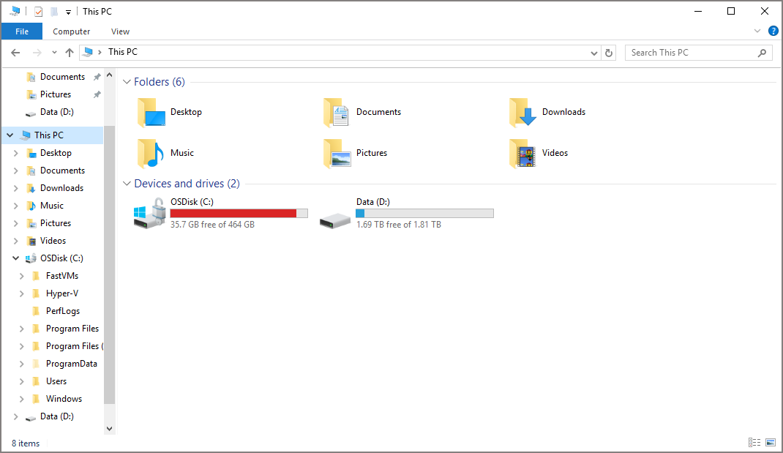
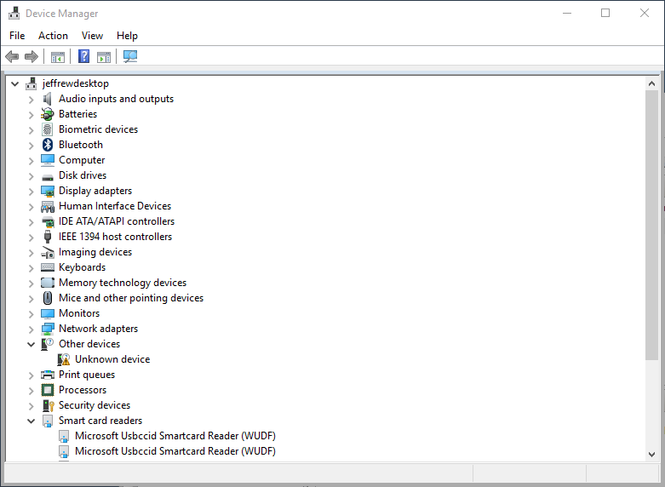
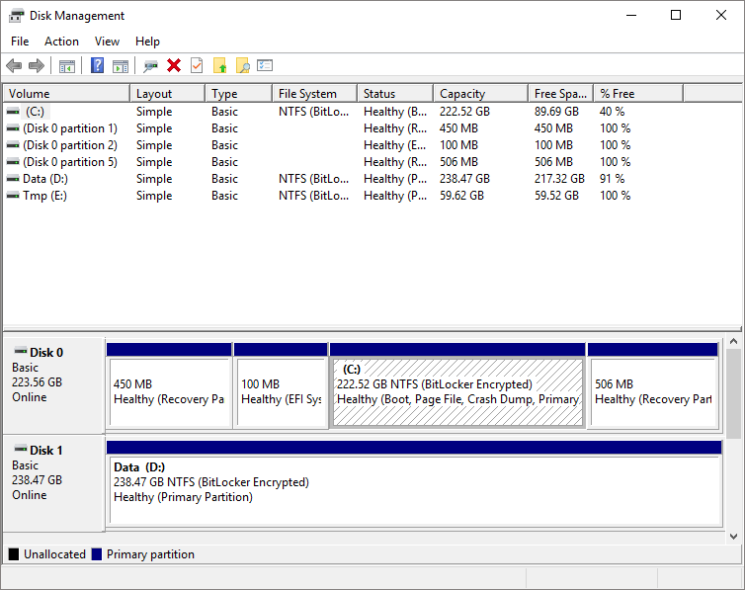

Slide 10
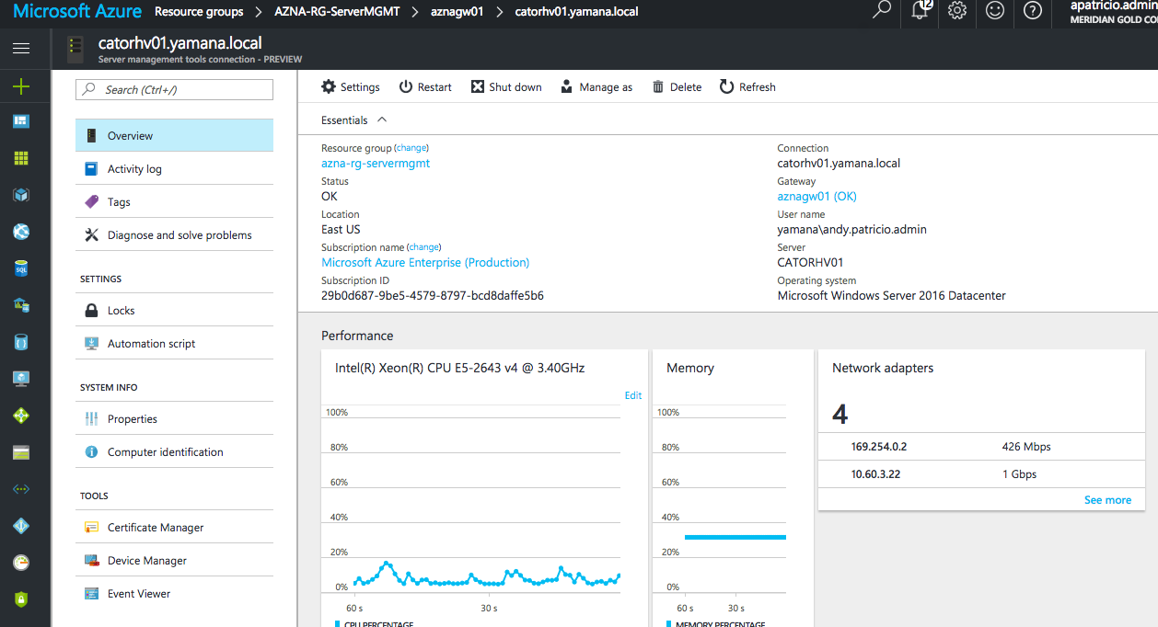
Windows Admin Center

Slide 11













Windows Admin Center - arhitektura
Internet
On-Premises
HTTPS
Web Server
Gateway
PowerShell / WMI over WinRM

Slide 12



Upravljanje s bilo kojeg mjesta
Internet
On-Premises

Slide 13










Windows Admin Center partneri

Slide 14
Azure AD authentication
NetWork 9
conditional access i multi-factor authentication
web browser traži Windows account credentials za mašinu na kojoj je instaliran WAC
dodatni prompt traži username i password za Azure AD account kojem smo u Azureu dali prava pristupa na WAC
ne vrijedi za user accounte s admin pravima na WAC mašini
Notes:
Pokazati na WAC-u

Slide 15
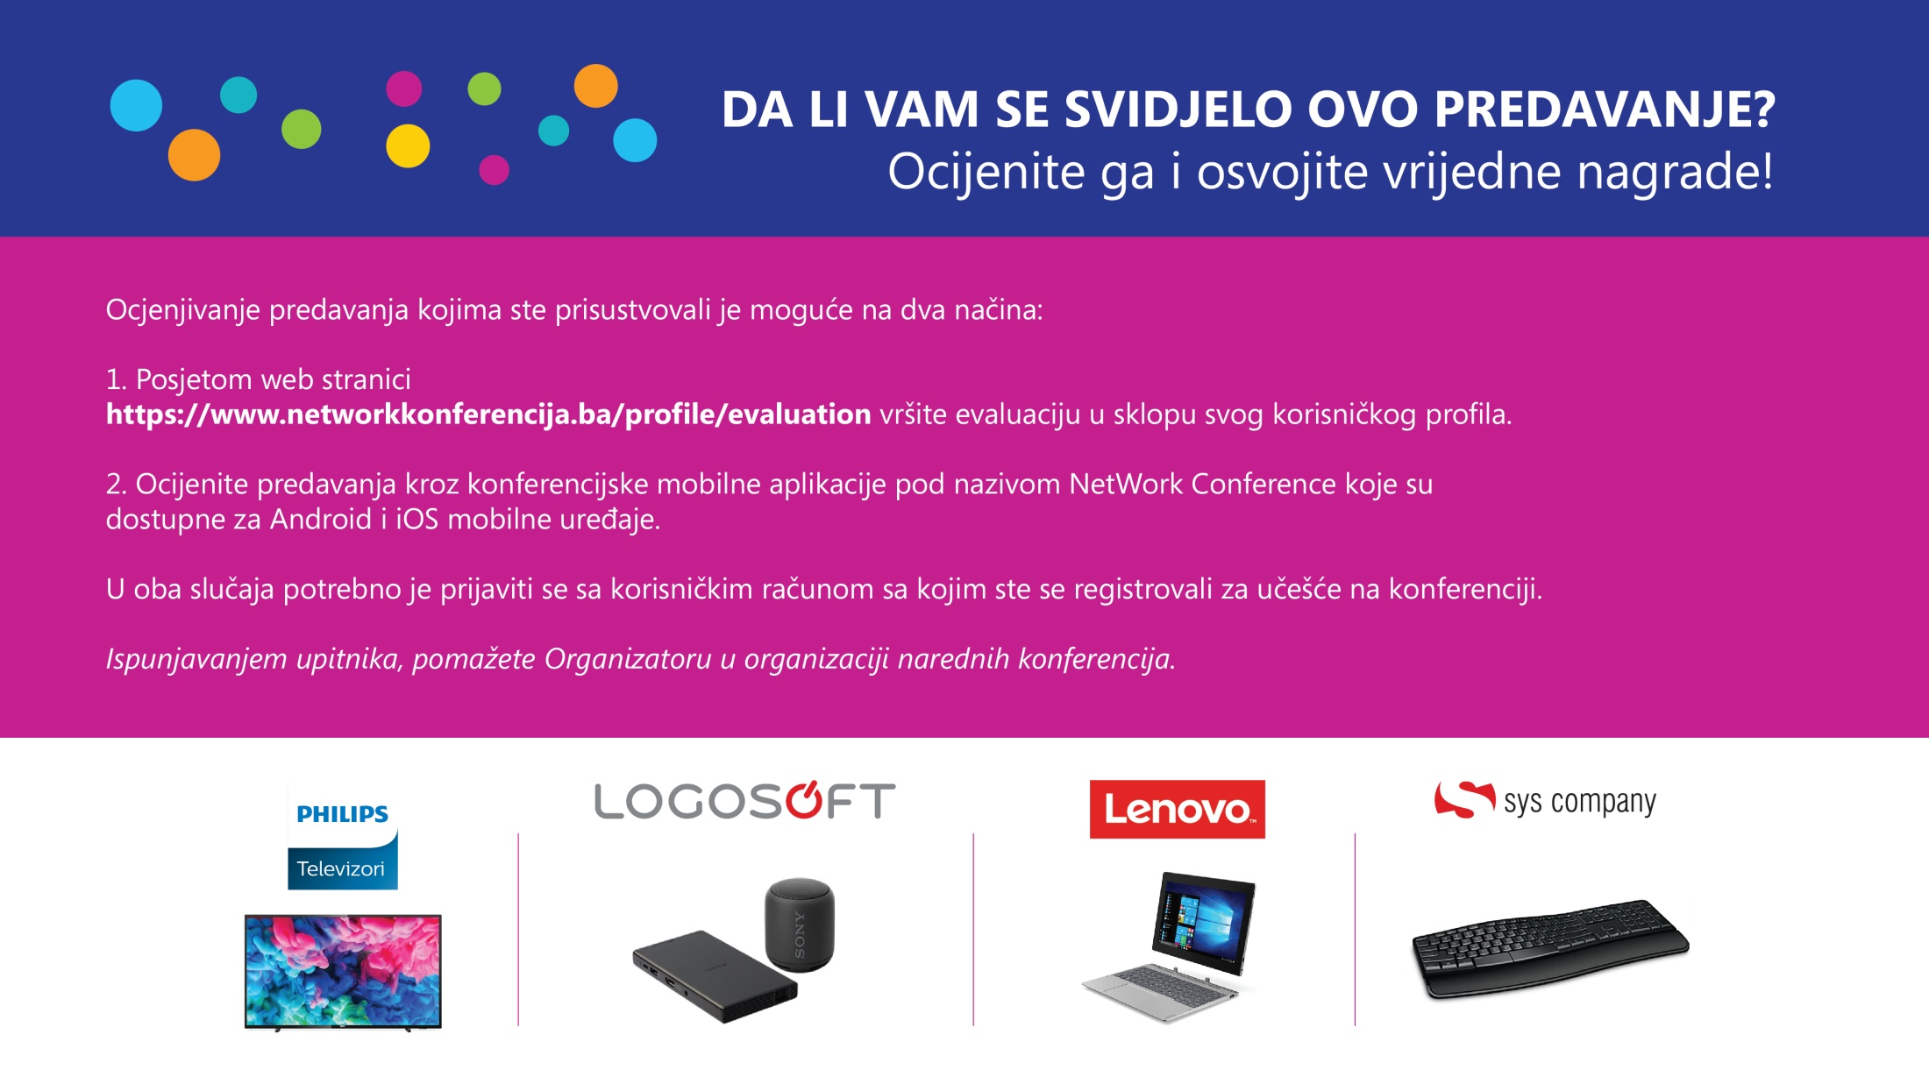

Slide 16
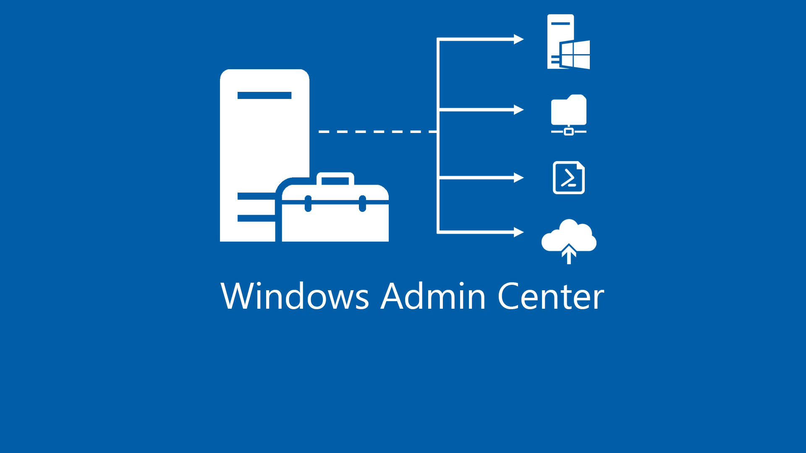
Hvala na pažnji! ☺

