Slide 1

Rastko Đorđević
Jelena Miodragović

Slide 2


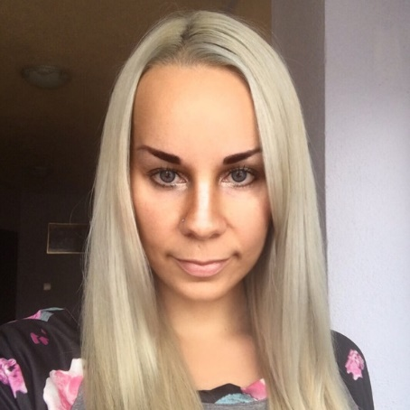
NetWork 9
Rastko Đorđević
Učenik ETŠ „Nikola Tesla“
Jelena Miodragović
Dipl. Ing. Informatike

Slide 3
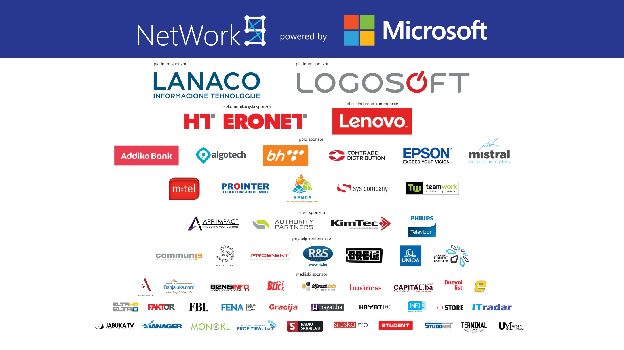

Slide 4

NetWork 9
What is Edge computing?
Microsoft’s solution
Particle’s solution
Device variety

Slide 5

DEMO

Slide 6

Q&A?

Slide 7

Thank you!

Slide 8


