Slide 1

Just add water: Azure IoT accelerator solutions
Catalin Gheorghiu
I Computer Solutions

Slide 2
Just add water: Azure IoT accelerator solutions
Catalin Gheorghiu
Solution Architect
I Computer solutions

Slide 4
Menu ☺
Azure IoT how you will do a solution?
Azure IoT accelerator solutions

Slide 5
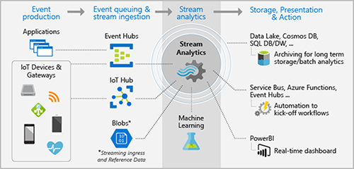

Slide 6
Demo
Azure IoT seat of the pants solution (AKA by experts ☺)

Slide 7
PaaS – Azure IoT Suite
Ideal for solutions that require ultimate control
Preconfigured solutions
Open source – customizable \ extensible
Deploy in minutes
Accelerate time to value

Slide 8
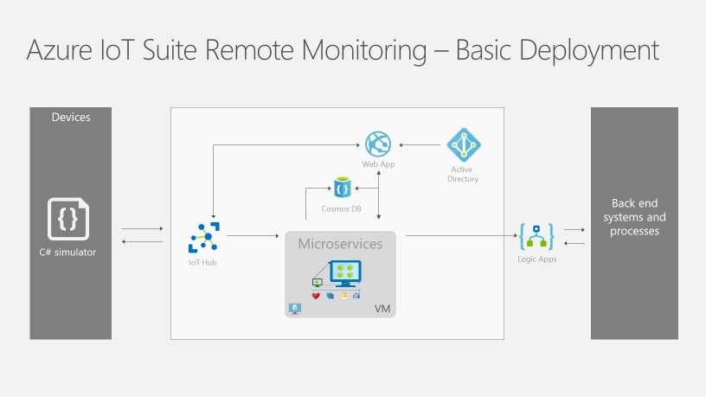

Slide 9
Demo
Azure IoT Suite Remote Monitoring V2

Slide 10
SaaS – Microsoft IoT Central
Ideal for straightforward IoT needs
No cloud solution development expertise required
Configurable to your needs
Fully managed by Microsoft
Notes:
Personas

Slide 11
Demo
Microsoft IoT Central

Slide 12
Thank you!
Hvala vam!
Catalin Gheorghiu
My Email
catalin.gheorghiu@ronua.ro

