Slide 1


Automated Machine Learning
Dr. Sc. Bahrudin Hrnjica
bhrnjica@hotmail.com
@bhrnjica

Slide 2
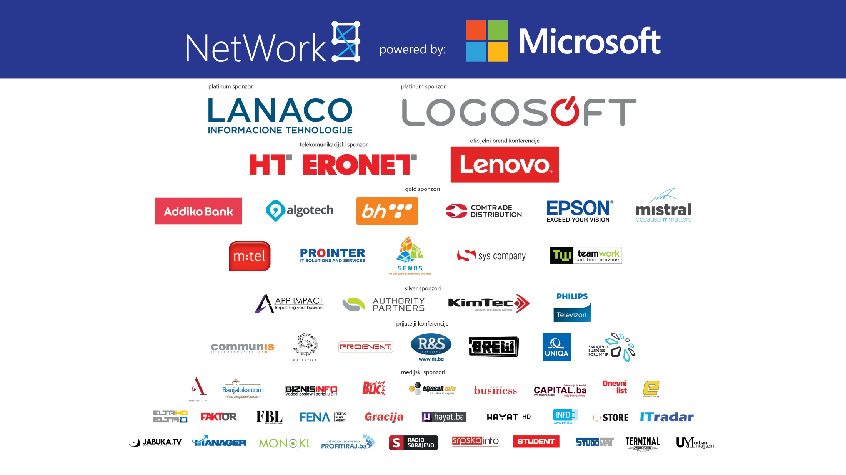

Slide 3

Agenda
Intro to Machine Learning
Azure Machine Learning
Automated Machine Learning
How to Start with Azure ML
Demo
  How to setup Azure ML,
  Automated ML in Action
  Deploy ML model as a service
Summary

Slide 4





Machine Learning
…
A / अ
Self-driving cars
Machine Translation
Predictive maintenance
Image recognition
Forecasting
E-commerce recommend-ations

Slide 5
ML Lifecycle
1. define problem
2. acquire + process data
6. deploy
3. design model architecture
5. test/evaluate
4. train model
a. Initialize and select ml algorithm
y =Wx + b
b. feed in minibatch of data
e. update weights
d. optimize: minimize loss
c. calculate loss
δ
loss = |desired – actual outcome|

Slide 6
Azure AI
AI apps & agents
Machine learning
Knowledge mining
Azure Bot Service
Azure Cognitive Services
Azure Databricks
Azure Machine Learning
Azure Cognitive Search

Slide 7


Azure ML Process
SQL DB
Cosmos DB
Datawarehouse
Data lake
Blob storage
…
Prepare Data
Build & Train
Deploy

Slide 8
Machine Learning Problem Example
How much is this car worth?

Slide 9
Model Creation Is Typically Time-Consuming
Which features?
Which algorithm?
Which parameters?
Mileage
Condition
Car brand
Year of make
Regulations
…
Gradient Boosted
Nearest Neighbors
SVM
Bayesian Regression
LGBM
…
Parameter 1
Parameter 2
Parameter 3
Parameter 4
…
Mileage
Gradient Boosted
Criterion
Loss
Min Samples Split
Min Samples Leaf
Others
Car brand
Year of make
30%
Model

Slide 10
Model Creation Is Typically Time-Consuming
Which features?
Which algorithm?
Which parameters?
Mileage
Condition
Car brand
Year of make
Regulations
…
Gradient Boosted
Nearest Neighbors
SVM
Bayesian Regression
LGBM
…
Criterion
Loss
Min Samples Split
Min Samples Leaf
Others
Mileage
Gradient Boosted
N Neighbors
Weights
Metric
P
Others
Condition
Nearest Neighbors
Car brand
Car brand
50%
Year of make
30%
Year of make
Model
Iterate

Slide 11
Model Creation Is Typically Time-Consuming
Which features?
Which algorithm?
Which parameters?
30%
50%
70%
30%
45%
50%
65%
95%
35%
10%
75%
20%
70%
30%
15%
Iterate

Slide 12
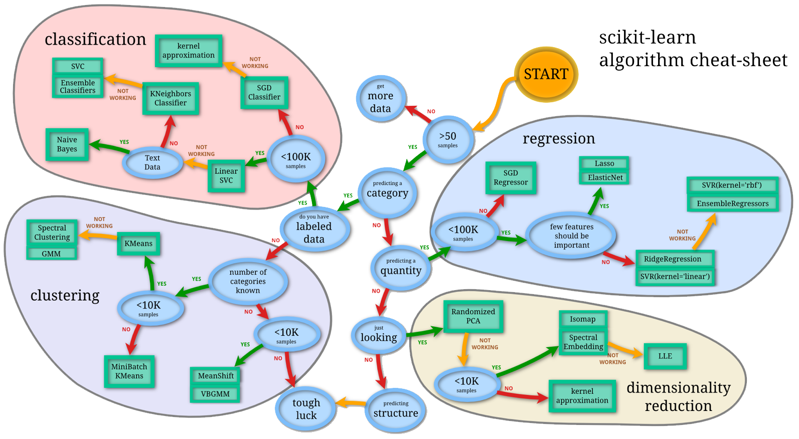
Machine Learning Complexity
Source: http://scikit-learn.org/stable/tutorial/machine_learning_map/index.html

Slide 13
What is automated machine learning?
Automated machine learning (automated ML) picks an algorithm and hyperparameters for you and generates a model ready for deployment. The model can be downloaded to be further customized as well.

Slide 14
Automated ML
Cycle
Data
Feature
Algorithm
Tuning
Ranking
Explaining






Data cleaning support
Feature engineering
Pick and play
What to leave out
Ranking
Justification
Automated ML currently supports automated data cleaning
Most time consuming part when done manually can now be done within minutes.
Testing many different algorithms at once.
Hyperparameter tuning: what to include what to leave out
Having an overview of the best performing models based on accuracy & speed.
Being able to explain what created an outcome and what features had the most significant impact

Slide 15

Model Selection & Hyperparameter Tuning
Dataset
Model Training
Infrastructure
Training Algorithm 1
Training Algorithm 2
Model 1
Model 2
Model 3
Model 4
Hyperparameter
Values – config 1
Hyperparameter
Values – config 2
Hyperparameter
Values – config 3
Hyperparameter
Values – config 4
Repetitive & Manual

Slide 16
Introducing Automated Machine Learning
Dataset
Optimization
Metric
Automated ML
ML Model
Constraints
(Time/Cost)
Accessible & Faster

Slide 17
Automated ML Accelerates Model Development
Input
Intelligently test multiple models in parallel
Output
25%
Optimized model
25%
40%
Enter data
70%
25%
40%
70%
95%
95%
Define goals
25%
40%
70%
25%
40%
25%
70%
Apply constraints
40%

Slide 18




Microsoft Automated ML Differentiators
Azure Cloud offering
Data privacy
Integration with data platforms
Meta-learning
Is a part of Azure Cloud
no data movement needed
ex: PowerBI, SQL, CosmosDB
gets better with customer usage

Slide 19

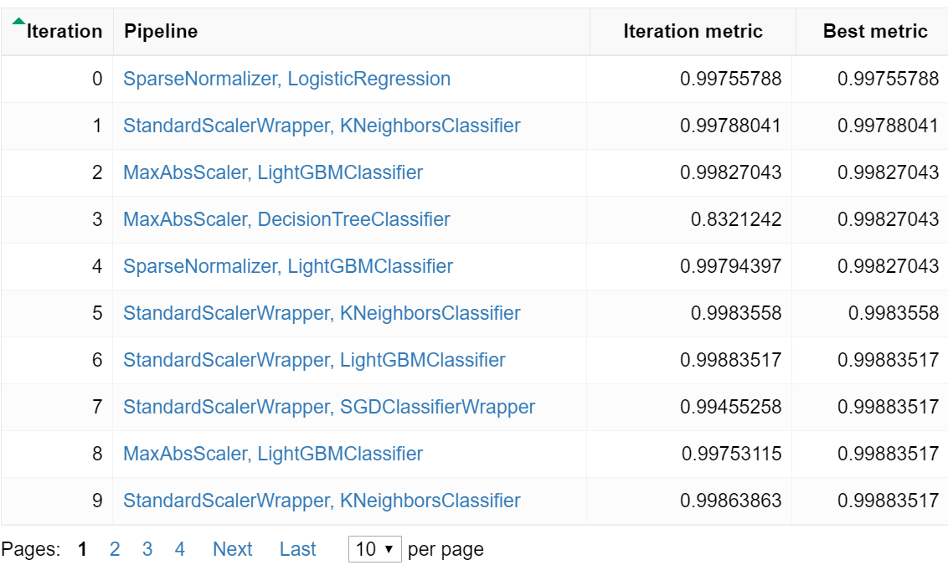


Automated ML – User Experience
Python Script
Automated ML
Models (User Compute – Local or Cloud)
Configuration
Submit
Train
Generate Algorithms & Hyperparameter values
Dataset
Output
High Quality Machine Learning Model

Slide 20
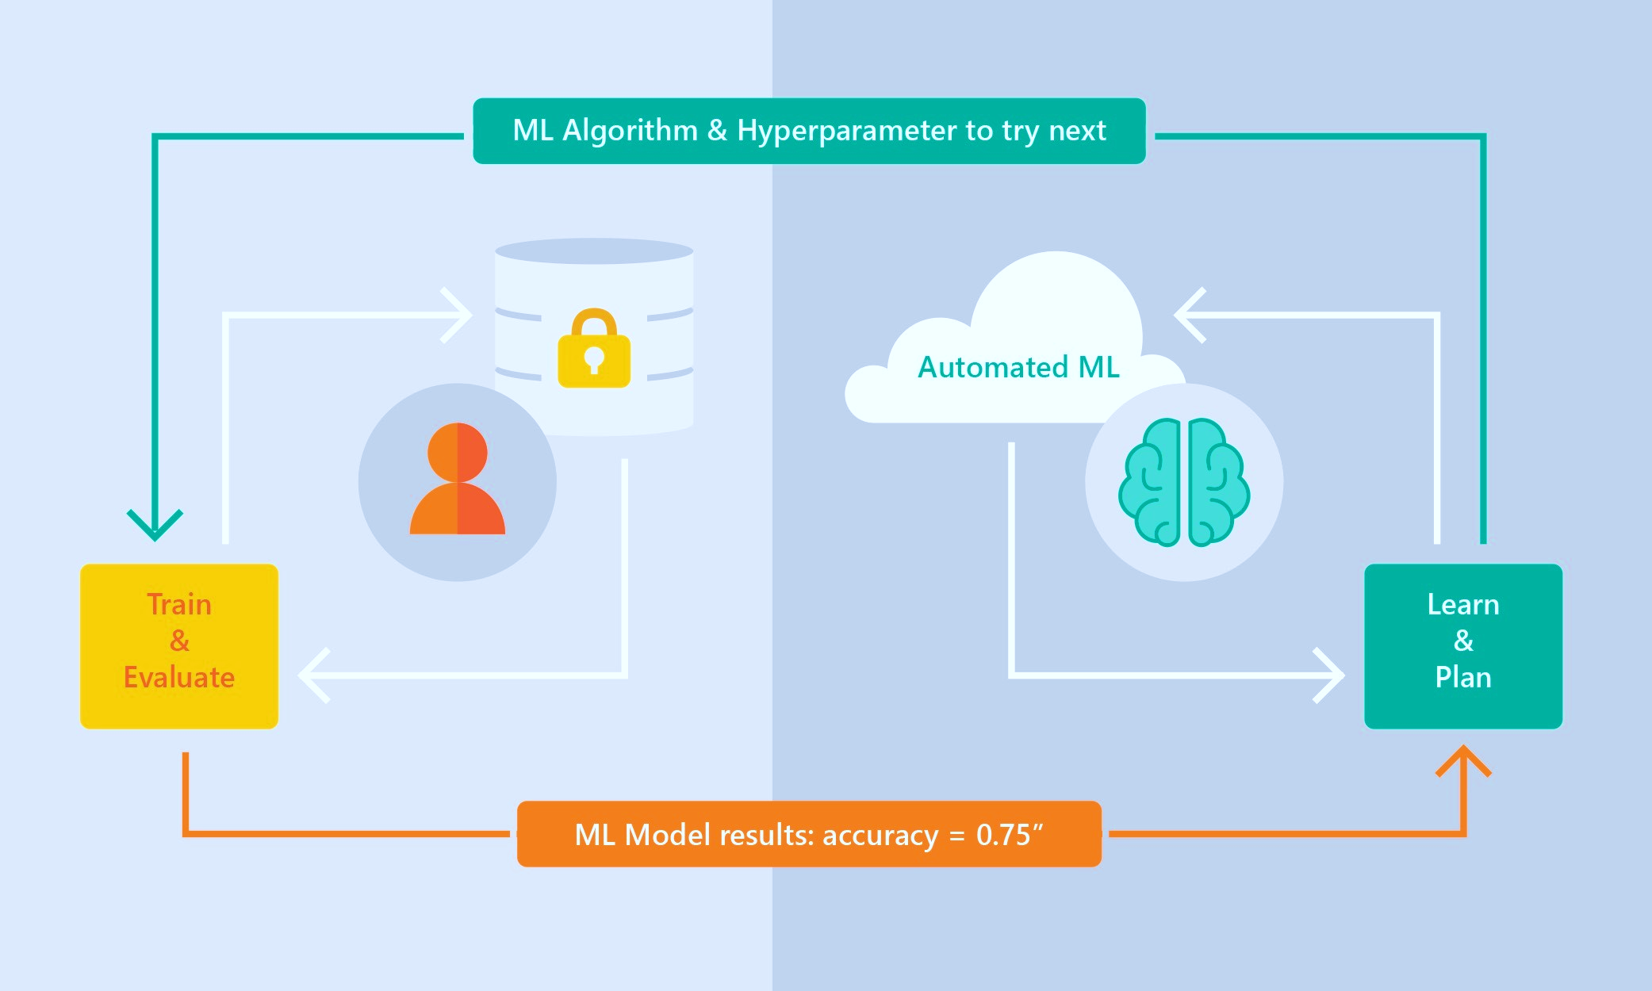
Automated ML Capabilities
ML Scenarios: Classification & Regression, Forecasting*
Integration: Azure Machine Learning, Azure Notebooks, Jupyter Notebooks
Data Type: Numeric, Text
Languages: Python SDK for deployment and hosting for inference
Training Compute: Local Machine, Remote Azure DSVM (Linux), Azure Compute, Azure Databricks*
Transparency: View run history, model metrics
Scale: Faster model training using multiple cores and parallel experiments
* In Preview

Slide 21
Automated ML Capabilities
Based on Microsoft Research
Brain trained with several million experiments
Collaborative filtering and Bayesian optimization
Privacy preserving: No need to “see” the data

Slide 22
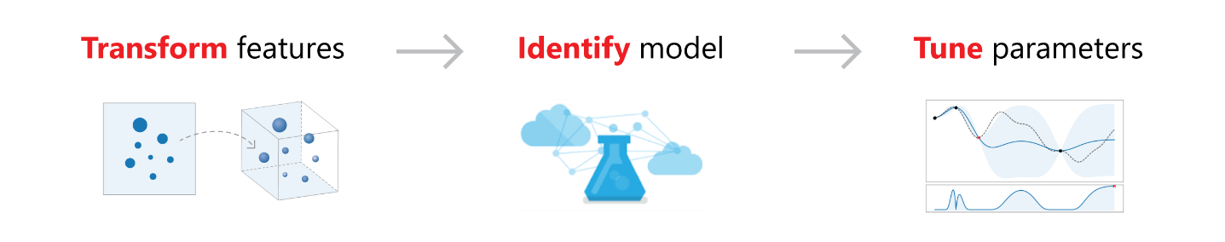
Feature Engineering
Dropping high cardinality or no variance features
Features with no useful information are dropped from training and validation sets. These include features with all values missing, same value across all rows or with extremely high cardinality (e.g., hashes, IDs or GUIDs).
Missing value imputation
For categorical features, missing values are imputed with most frequent value. For numerical features, missing values are imputed with average of values in the column
Generating additional features
For DateTime features: Year, Month, Day, of week/ of year, Quarter, Week of the year, Hour, Minute, Second.
For Text features: Term frequency based on word unigram, bi-grams and Char tri-char, Count vectorizer
Transformations and encodings
Numeric features with very few unique values are transformed into categorical features. Depending on cardinality of categorical features label encoding or (hashing) one-hot encoding is performed

Slide 23
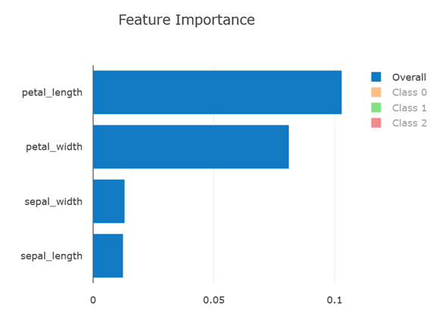
Model Explain-ability [Preview]
GA:
Feature importance as part of training
Simple UX for feature importance for a selected iteration
Local feature importance for a given sample
Post GA:
Importance of Raw data columns
Accuracy and performance improvements

Slide 24
Time Series Support [Preview]
Grain Index Featurization & Grouping
Missing row imputation, including target column
Improved time index featurization
Guidance on time-series specific train/validation/test split
Drop Column
Coming soon
Lagging features
Time aggregations, sliding window features

Slide 25

Demo:
How to Start with Azure Machine Learning

Slide 26
Demo:
Train models with Auto Machine Learning

Slide 27
Summary
AutoML new generation of Machine Learning
Let algoritm select the best strategy to get ML model
Azure Machine Learning one of the best ML platform
AutoML the future of ML

Slide 28


