Slide 1
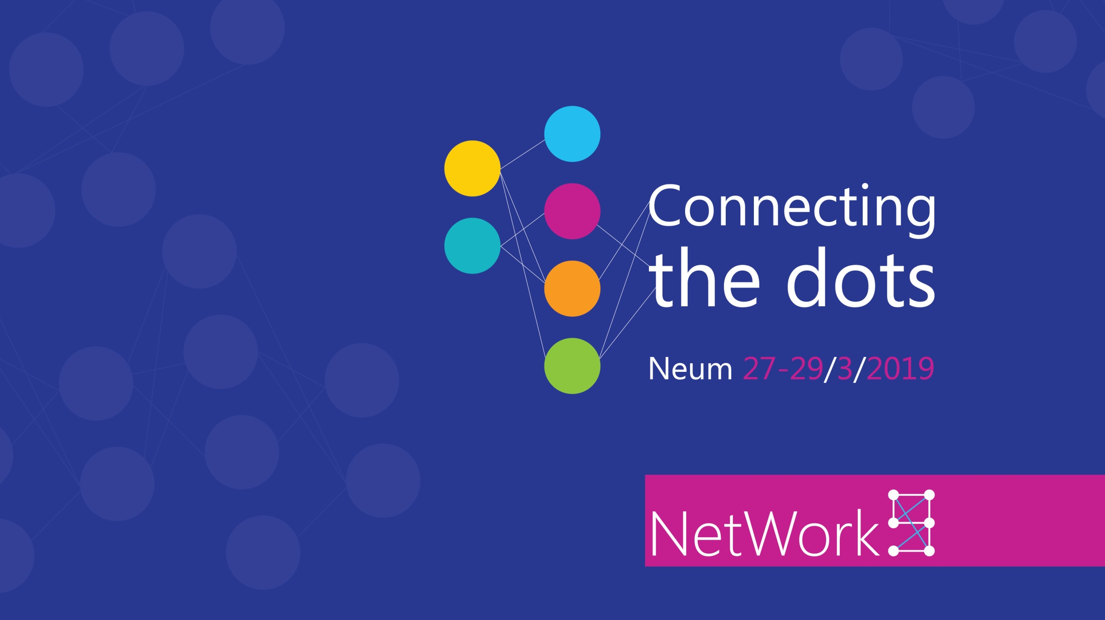
PowerApps
Issues and fixes
Adis Jugo, MVP

Slide 2
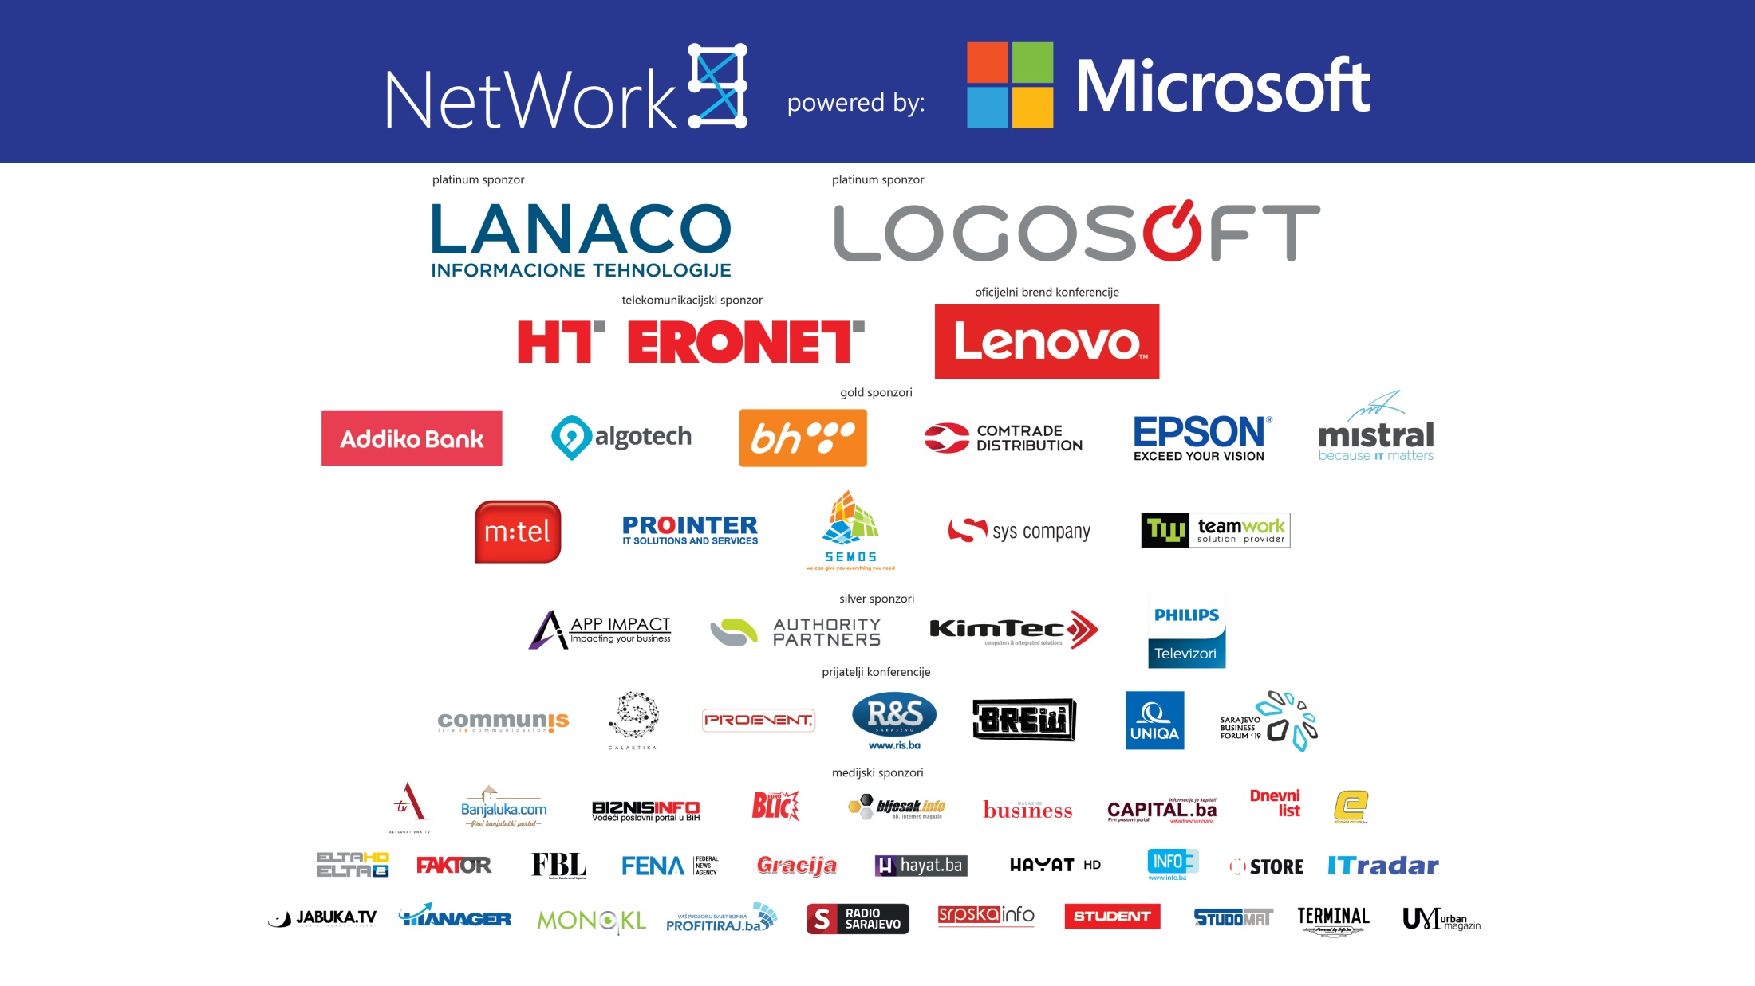

Slide 3
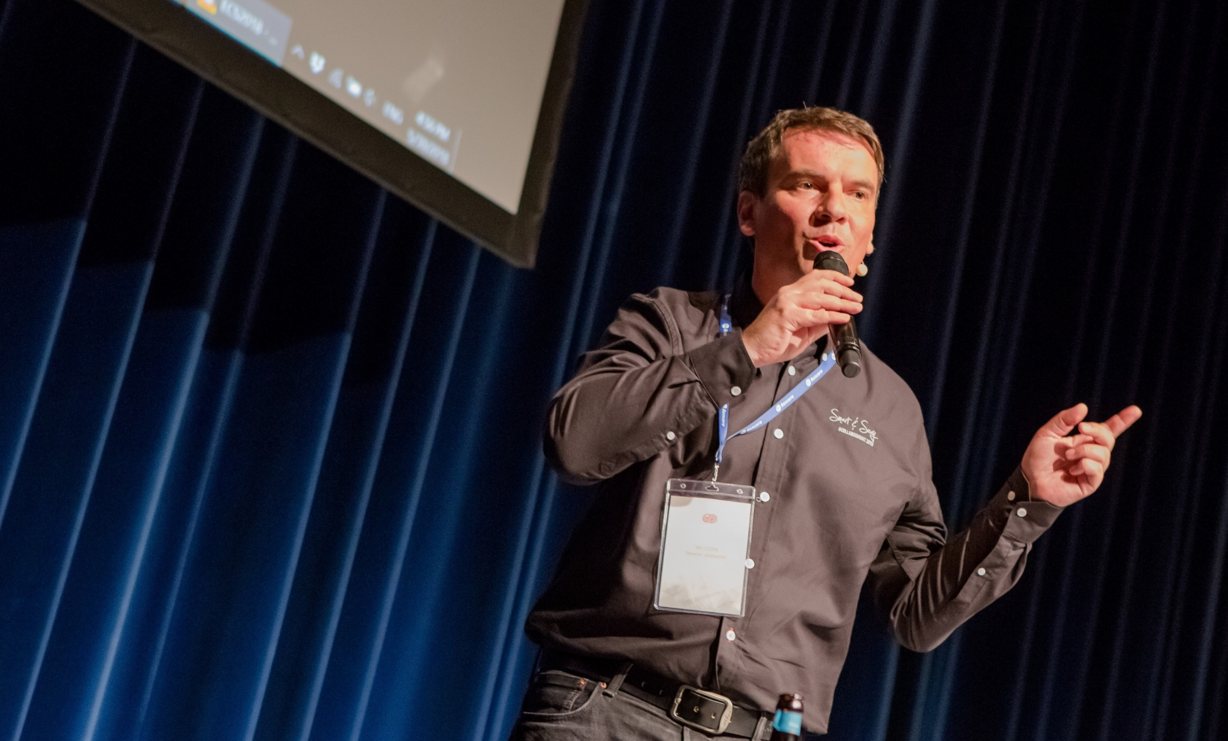
Adis Jugo
Microsoft MVP Office Apps and Services
Microsoft MVP Office Development
In IT for way too long (first money earned with development in 91)
Still dreaming of a restaurant or a vineyard
Mastermind behind European Collaboration Summit (www.collabsummit.eu)
Born in Sarajevo, Bosnia, living in Bingen, Germany
Blogger, speaker, author. adisjugo.com
Notes:
VS 2013 with console
VS 2013 empty
VS 2012 with WP emulator
SP Designer
Microsoft Azure (IE)
Win Dev Portal (IE)
Dev site (Chrome)

Slide 4
AGENDA
PowerApps, Quick Intro
I an confused, what should I use? => Discussing Canvas vs Model
How do I protect myself? => Data Policies
The big unknown? => Permissions and Roles
Cascading Lookups? => Understanding Cards
Working with Underlying data? => The patch mystery
Help, I am out of context! => Getting User and SharePoint Context
Why is this not possible? => Adding custom functionality
I am done, how do I deploy this? => App packaging, export/import

Slide 5
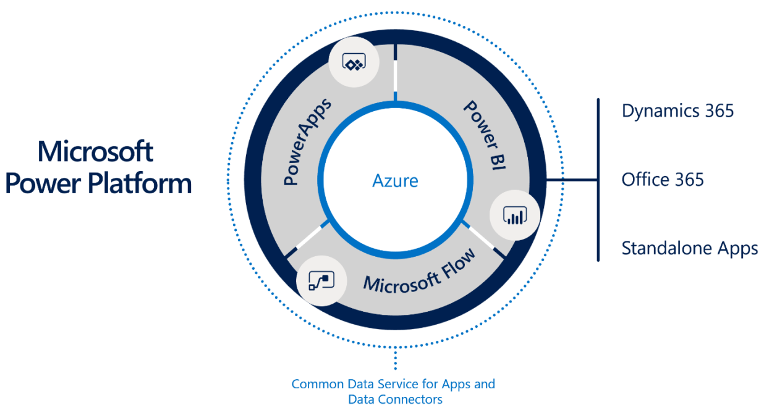
Microsoft PowerApps

Slide 6
Use PowerApps & Flow
InfoPath/
SharePoint Designer
No new versions, supported through 2026
Access Web Apps
PowerApps/ Flow
Successors to InfoPath forms, Access Web Apps and SharePoint Designer workflows

Slide 7
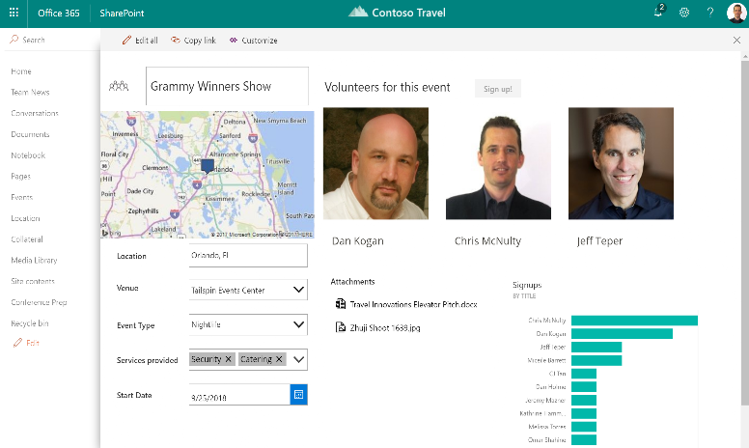
Custom forms with PowerApps
Built-in browser based
customization experience
Integrated to “modern”
SharePoint UX
Easy to customize

Slide 8
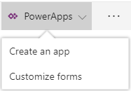

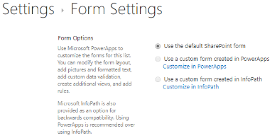

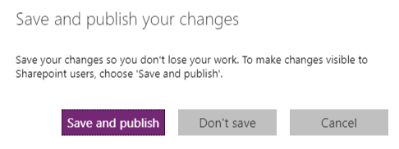
Embedded in SharePoint
Smooth transition between platforms
In SharePoint
In PowerApps

Slide 9
PowerApps use cases and scenarios
Extending PowerApps
Stand-alone apps
Complexity of creation
Embedded forms
Complexity of solution

Slide 10
Major issues / drawbacks with PowerApps
Limited SharePoint integration
  No DocLibs, limited support for some field types
  Integration via iFrame (DOM and context issues)
No complex forms
  Master-detail very difficult to implement
  Very basic form designer
Limited field validation and calculation
  Due to the limited expression language
  No validation controls/helpers
Not context aware
  User context and SharePoint context missing
No deployment scenarios
Process management only through Flow
  Premium Flow plans
  Only partially replacement for event handlers and timer jobs
  Fallback to custom code
Extensibility
  Custom Functions and API Apps for any extension
Manageability and operations
  Rollout issues
  No ALM story at all

Slide 11
I am confused, what should I use?
CANVAS VS MODEL DRIVEN APPS

Slide 12
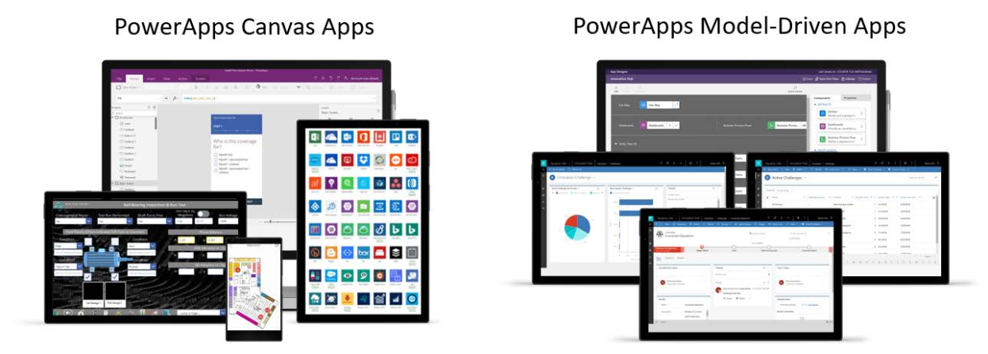
App Types
Canvas-Driven apps
  Starting from blank or simple data
  Data from different data sources
  You would use them with SP
  Free with most O365 plans
Model-Driven apps
  Starting from data models
  Data Always in CDS
  Dynamics 365 – inspired
  Plan 2 needed -40€/User/Month

Slide 13
How do I protect myself?
DATA POLICIES

Slide 14
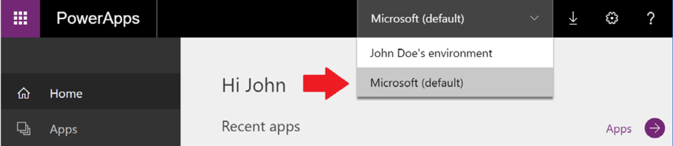
Environments
Physically separated areas
Own connectors, own permissions
Can have a CDS DB associated
Production, Default, Sandbox, Trial, Developer type of environments

Slide 15
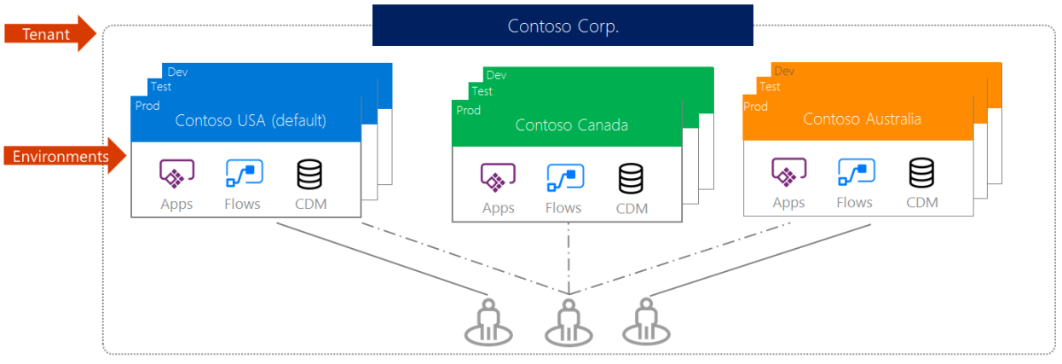
Environments

Slide 16
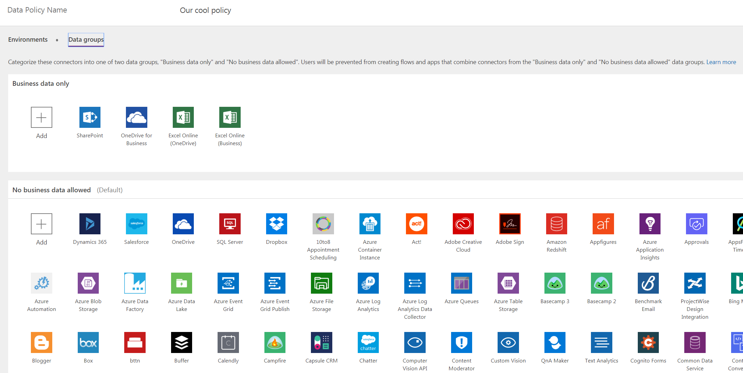
Data Policies

Slide 17
The big unknown
PREMISSIONS AND ROLES

Slide 18
Roles without CDS DB
(usually “Canvas”)
Environment Administrator
  Adding removing users
  Creating CDS instances
  Viewing and managing all resources
  Setting Data Loss Prevention Policies
Environment Maker
  Create and Share apps
  Create connectors
  Create gateways…

Slide 19
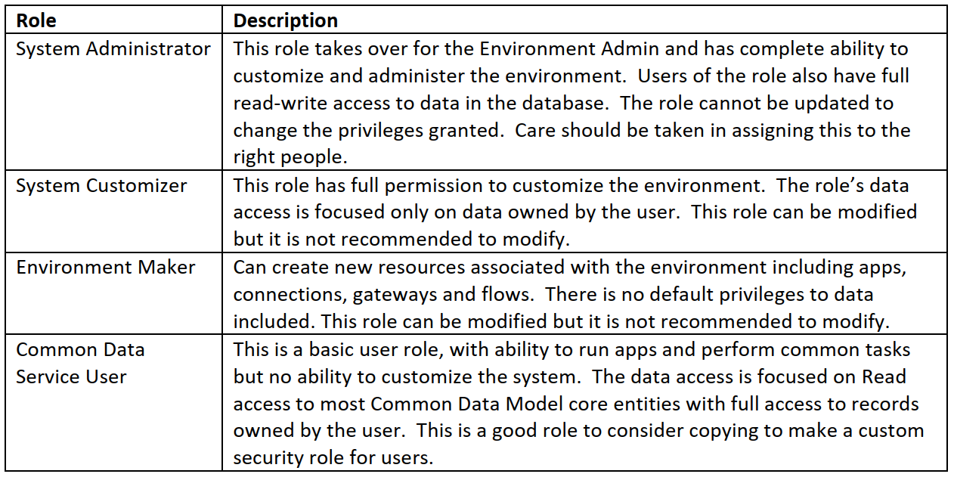
Roles with CDS DB (usually “Model”)

Slide 20
Cascading Lookups
UNDERSTANDING DATA CARDS

Slide 21
How data cards work
Data Source
(flat!)
Form control
Data Properties (fields)
Label
Input control
Error Message
UPDATE
…
…
…
SAVE

Slide 22
How data cards work
DATA CARD
WINES LIST
SharePoint Connector
One List
Wine name
Properties
Country
Properties
Region
Properties
Other fields
Properties
[Title]
Properties
[Array of countries]
Properties
[Array of regions]
Properties
[internal field names]
Properties

Slide 23
Cascading lookup: change the source
DATA CARD
WINES LIST
SharePoint Connector
One List
Wine name
Properties
Country
Properties
Region
Properties
Other fields
Properties
[Title]
Properties
[Array of countries]
Properties
[Array of regions]
Properties
[internal field names]
Properties
Second connector
REGIONS LIST

Slide 24
Cascading Lookup
Edit the data card of the 2nd lookup field, which is “dependent” on the first lookup field
Change the data source of the dropdown control to a separate data source, to list with items for the 2nd control
Filter that data source to show only the elements based on the selected value in the first dropdown control
  E.g. Filter(Regions, country.Id = drpCountry.Selected.Id)
Change the UPDATE property of the Data Card for the second control to e.g.
{Id: drpRegions.Selected.ID,
Value: drpRegions.Selected.Title,
'@odata.type': "#Microsoft.Azure.Connectors.SharePoint.SPListExpandedReference"
}
Copy the code from: https://pastebin.com/Dwz9Eq51

Slide 25
Working with underlying data
THE PATCH MISTERY

Slide 26
Scenarios
Adding related items on events
  Add a default “Region” when “Country” is created
  Edit all “Regions” after “Country” has been updated
  Delete all “Regions” after country has been deleted
One button with multiple actions on multiple data sources
Clean-up or any other processes on form events
…

Slide 27
Working directly with data sources (Patch)
Edit Item
Patch( Wines, First(Filter(Wines, Title = “Blatina" ) ), { Description: “Good wine” } )
Add item:
Patch( Wines, Defaults( Wines ), { Title: “Blatina” } )
Remove item:
Remove(Wines, First(Filter(Wines, Title =“Blatina”)))

Slide 28
Help, I am out of context!
Getting User and SharePoint Context

Slide 29
Scenario
User-specific screens
  Profile data
  SharePoint group memberships
SP Site Collection and SP Site Context
  Web URL
  Web properties
  Other context-relevant data

Slide 30
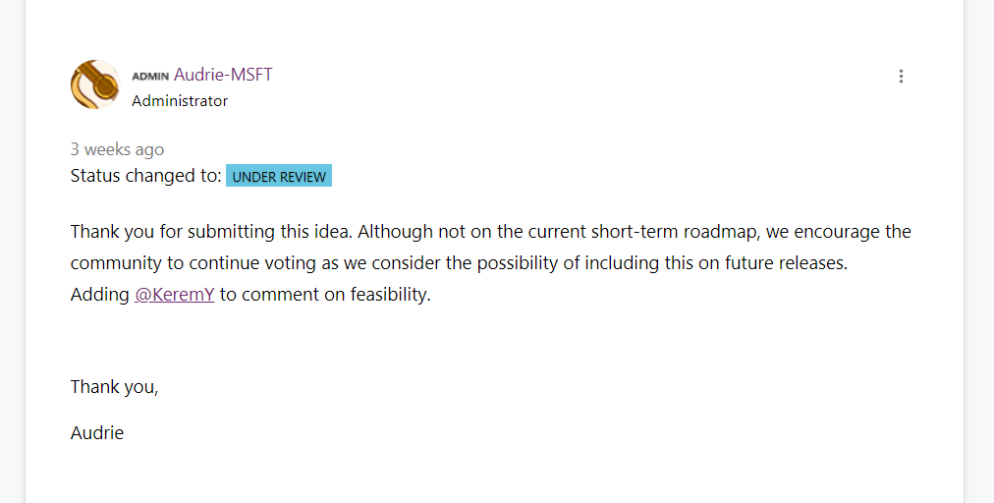
PowerApps: Missing SharePoint Context
SharePoint Context (security and permission context, site and web context, user profiles) are missing and will not be coming anytime soon

Slide 31
How does this work?
We will use Graph or SharePoint APIs
  Try to use Graph wherever possible
Create an AAD app
  Make sure to give all necessary permissions IN DELEGATED MODE
Take a look at the necessary Swagger definitions for the API
  Graph (https://github.com/microsoftgraph/microsoft-graph-openapi )
  SharePoint (https://www.dragan-panjkov.com/creating-swagger-descriptor-file-for-sharepoint-search-using-restunited-fiddler-and-notepad)
Create your swagger definition (as a subset of the above mentioned)
Create custom connector with that swagger definition
Create an app

Slide 32
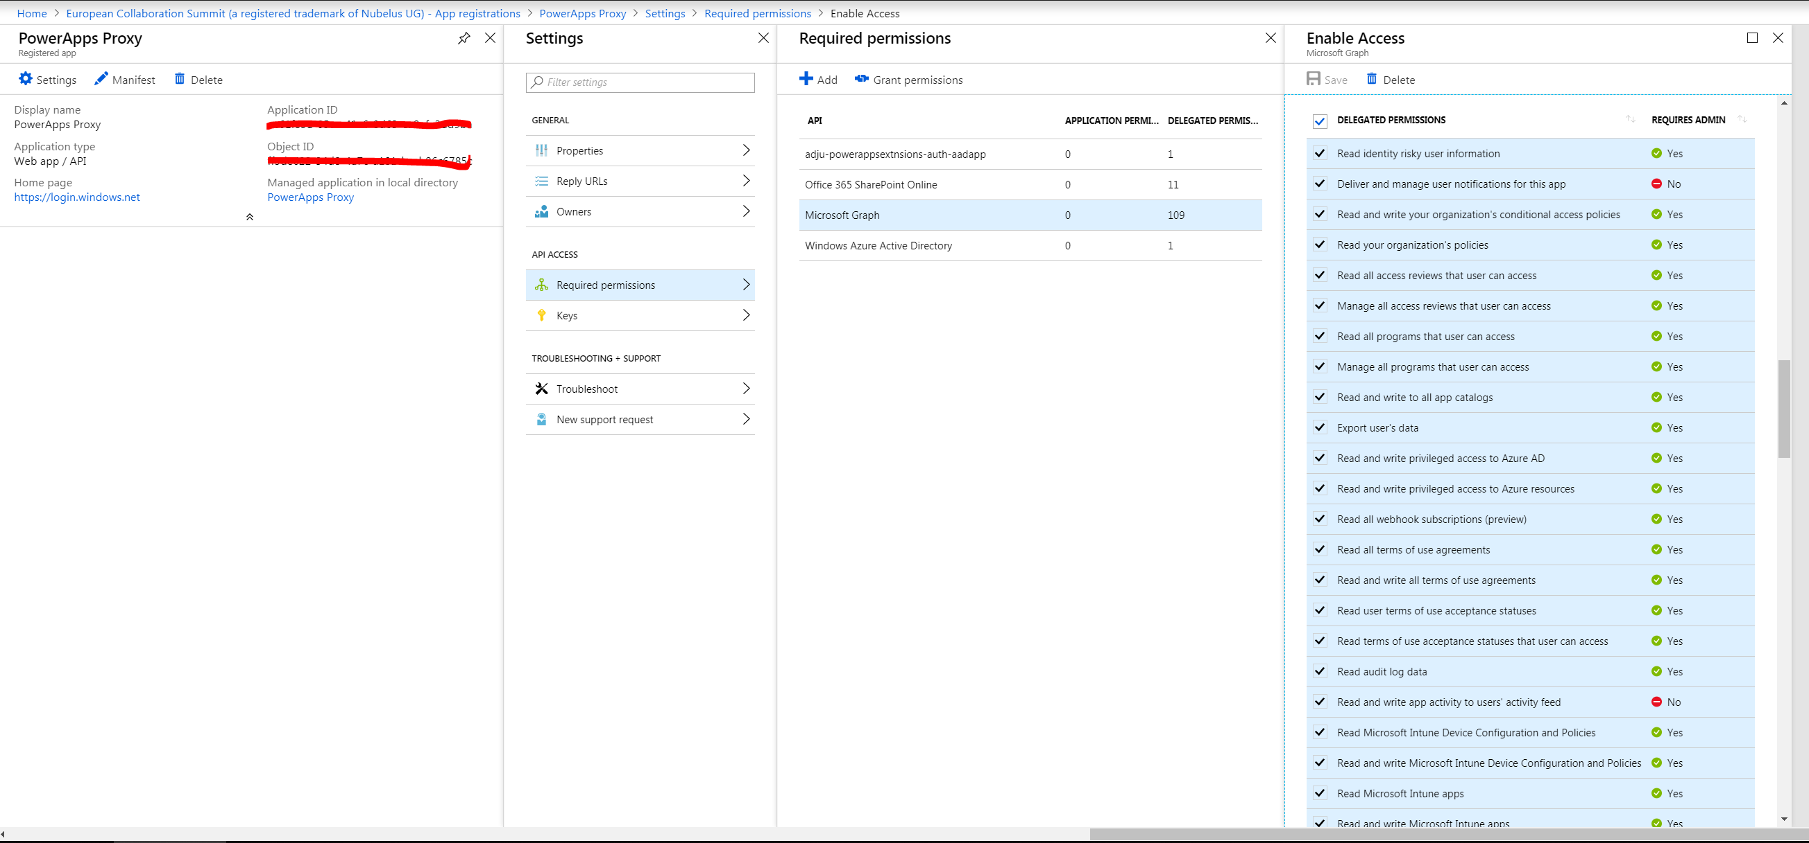

Slide 33
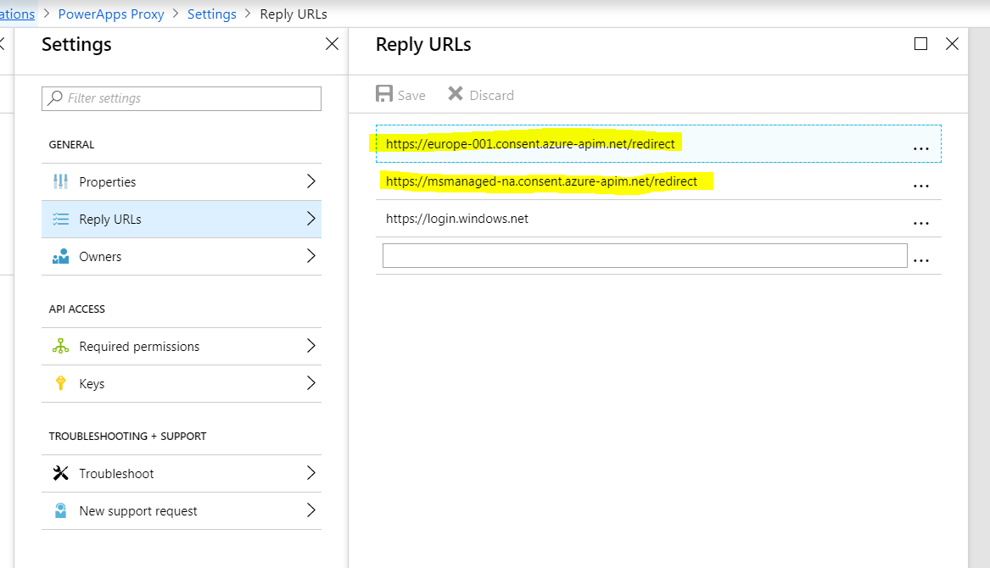

Slide 34
PowerApps Reply URLs for AAD Apps
Region | Reply URL
United States | https://msmanaged-na.consent.azure-apim.net/redirect
Europe | https://europe-001.consent.azure-apim.net
Asia | https://asia-001.consent.azure-apim.net
Australia | https://australia-001.consent.azure-apim.net
India | https://india-001.consent.azure-apim.net
Japan | https://japan-001.consent.azure-apim.net
Canada | https://canada-001.consent.azure-apim.net
Brazil | https://brazil-001.consent.azure-apim.net
UK | https://uk-001.consent.azure-apim.net

Slide 35
Why is it not possible?
Adding custom functionality

Slide 36
Scenarios
Non-existent functions in the expression language
Advanced calculations
Advanced validation
Triggering background processes which are not flow

Slide 37
AAD Authentication (witn inpersonation) between PA and AF
POWERAPP
PROXY AAD APP
AZURE FUNCTION
WHICH USES GRAPH OR SHAREPOINT APIS
TURN ON OAUTH2 AAD AUTHENTICATION
(AUTOMATICALLY CREATE AN AAD APP)
CREATE CONNECTOR. RESOURCE: AAD APP FOR OUTH.
USING: PROXY APP

Slide 38
I am done, how do I deploy this?
App packaging, export/import

Slide 39
YOU DON’T

Slide 40
Lifecyce Management
LifeCycle Management “light”
App Export and Import to ZIP file
Create “Solutions” from multiple PowerApps and Flows
Model-driven Apps will export related CDS components
Canvas-driven Apps cannot update connectors
  And this is the main problem with Canvas-Driven Apps

Slide 41
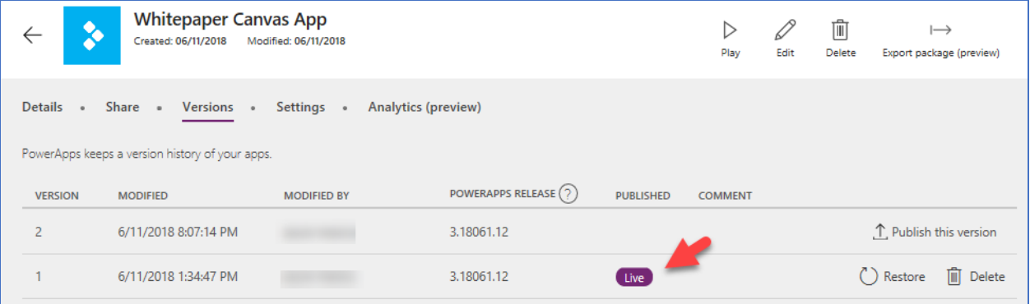
App Versioning
Editors see „Working version“
Publish version to „Live“
Users see “Live” version

Slide 42
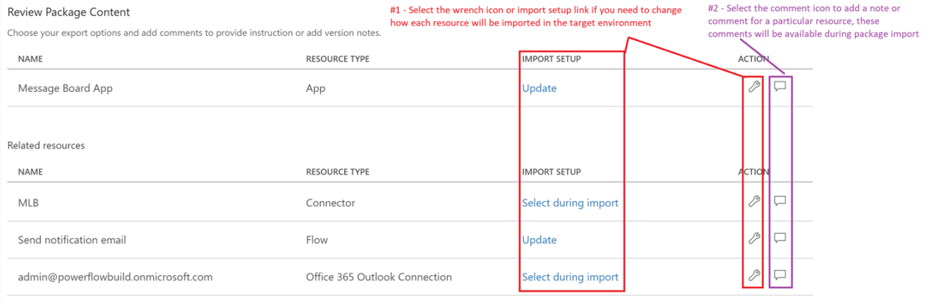
Setting up Export packages

Slide 43
Importing Apps
Custom connectors and CDS customizations has to be set up prior to import
If “Update” action is chosen, you will have to manually “publish” app
No app dependencies – EACH APP WILL LIVE ON IT’S OWN
Recently: bundling Apps and Flows in Solutions

Slide 44
Managed and unmanaged solutions
Model-Driven with CDS only
There are managed and unmanaged solutions. A managed solution cannot be modified and can be uninstalled after it is imported. All the components of that solution are removed by uninstalling the solution.
When you import an unmanaged solution, you add all the components of that solution into your environment. You can’t remove the components by uninstalling the solution.
When you import an unmanaged solution that contains components that you have already customized, your customizations will be overwritten by the customizations in the imported unmanaged solution. You can’t undo this.

Slide 45
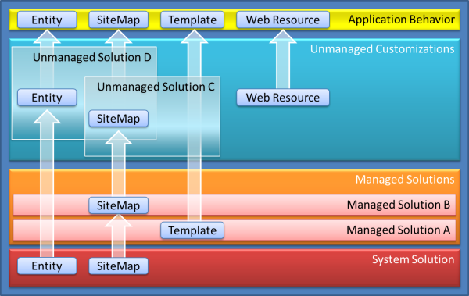
How solutions are applied in model-driven apps with CDS

Slide 46
