Slide 1

Šta je novo u
Visual Studio 2019?
Marko Lohert
Senior software developer, Ekobit

Slide 2


Slide 3

Agenda
NetWork 9
Visual Studio 2019
Demo: Nova ASP.NET Core 3.0 aplikacija
Demo: C# 8 + WPF .NET Core 3.0
Live Share

Slide 4

Visual Studio 2019
NetWork 9
Tri izdanja:
  Community
  Professional
  Enterprise
Datum izdavanja: 2. 4. 2019.

Slide 5
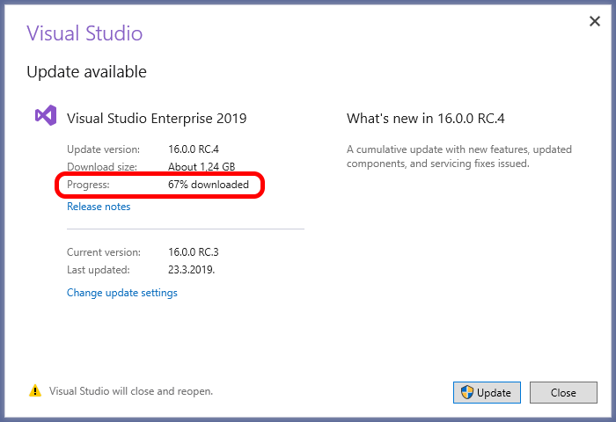
Visual Studio 2019
NetWork 9
Poboljšane performanse
Per-Monitor Awareness (PMA)
Download updates u pozadini

Slide 6
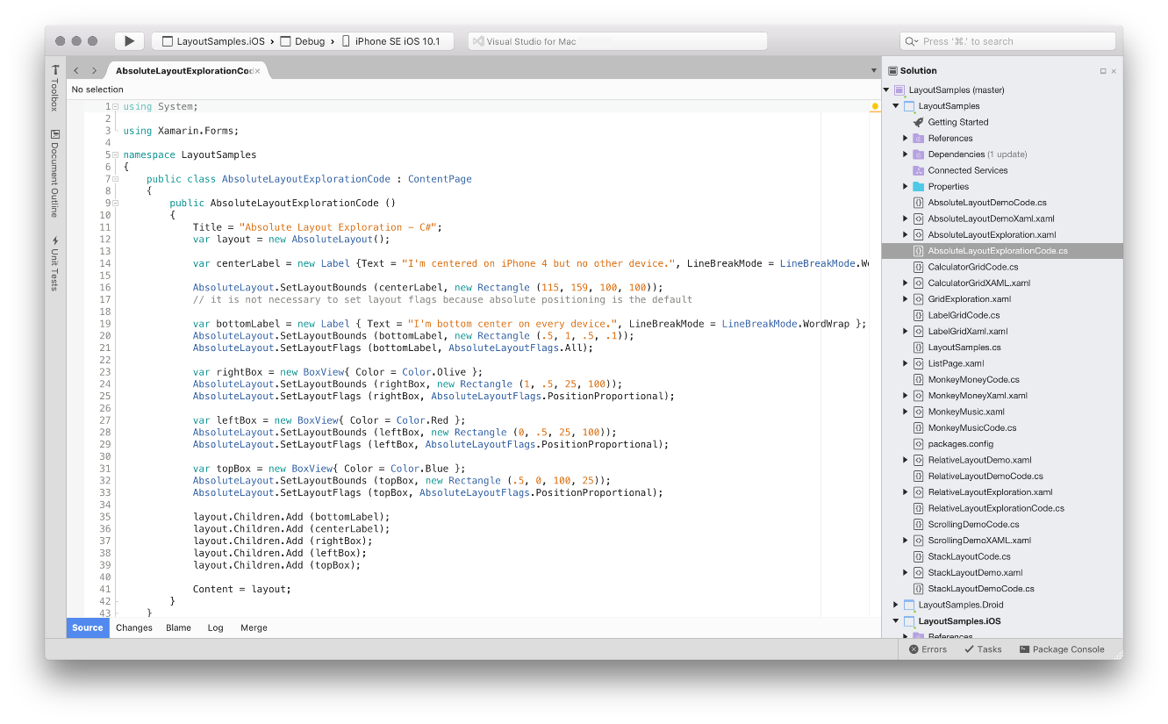
Visual Studio for Mac
NetWork 9
Napisan iz početka

Slide 7

Demo
Nova ASP.NET Core 3.0 aplikacija

Slide 8
Demo
C# 8 + WPF .NET Core 3.0

Slide 9
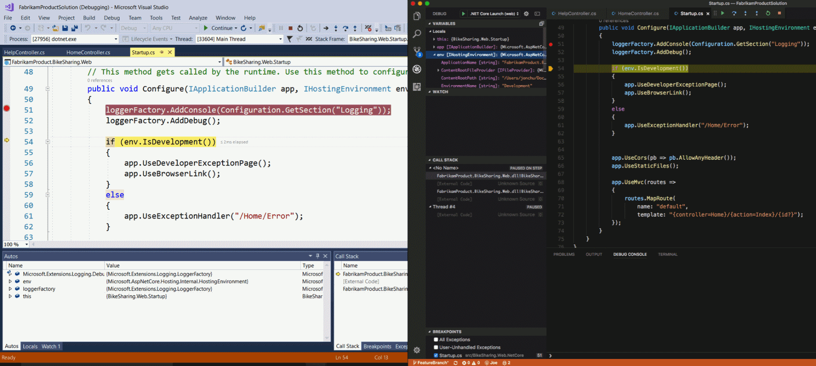
Live Share
NetWork 9
Real-time suradnja programera na istom kodu, ali na udaljenim računalima

Slide 10
Live Share
NetWork 9
Dijeljenje koda i stanja Visual Studia
  Trenutna lokacija koda
  Udaljeno upravljanje (Step Into, Step Over…)
Visual Studio IDE + Visual Studio Code

Slide 11
Σ Visual Studio 2019
NetWork 9
Novi Start window + New project wizard
Evolucija Visual Studio UI
Code Cleanup
Search u debug prozorima (Watch, Locals …)
Data breakpoints u C#-u
…

Slide 12
Σ Visual Studio 2019
NetWork 9
Podrška za C# 8 i .NET Core 3.0
Live Share

Slide 13

Q & A

Slide 14

Links
NetWork 9
Download VS 2019 (RC)
 | visualstudio.microsoft.com/downloads
VS 2019 Launch Event (2.4.2019.)
 | visualstudio.microsoft.com/vs2019-launch

Slide 15


