Slide 1

Azure Data Factory, servis za modernu obradu podataka u cloudu,
Ratomir Vukadin

Slide 2


Slide 3


Ratomir Vukadin, DevOps Engineer, Klika doo
MCT 2019, MCSA for Web Applications, MCSD
MS Network8, SQLSaturday 2018, WinDays19 etc
https://www.linkedin.com/in/ratomir-vukadin-rvs/
https://github.com/Ratomir?tab=repositories
@Ratko_V

Slide 4
Level 300
Azure Portal, Azure SQL Database, Azure Cosmos DB, HDInisght, Hive code

Slide 5



Agenda
Overview
Overview of Architecture
Preview of…?

Slide 6
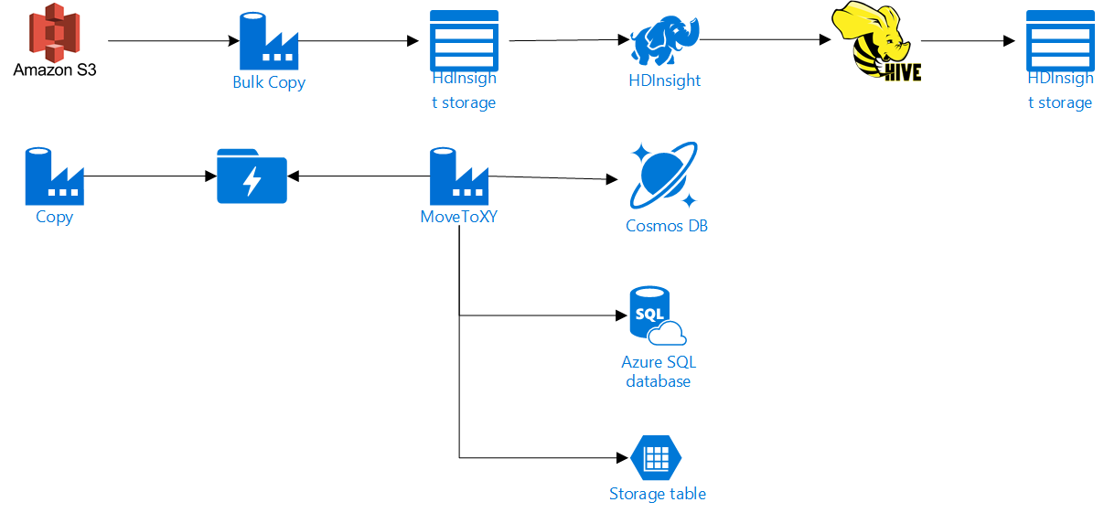

Slide 7
Overview of
Azure Data Factory

Slide 8

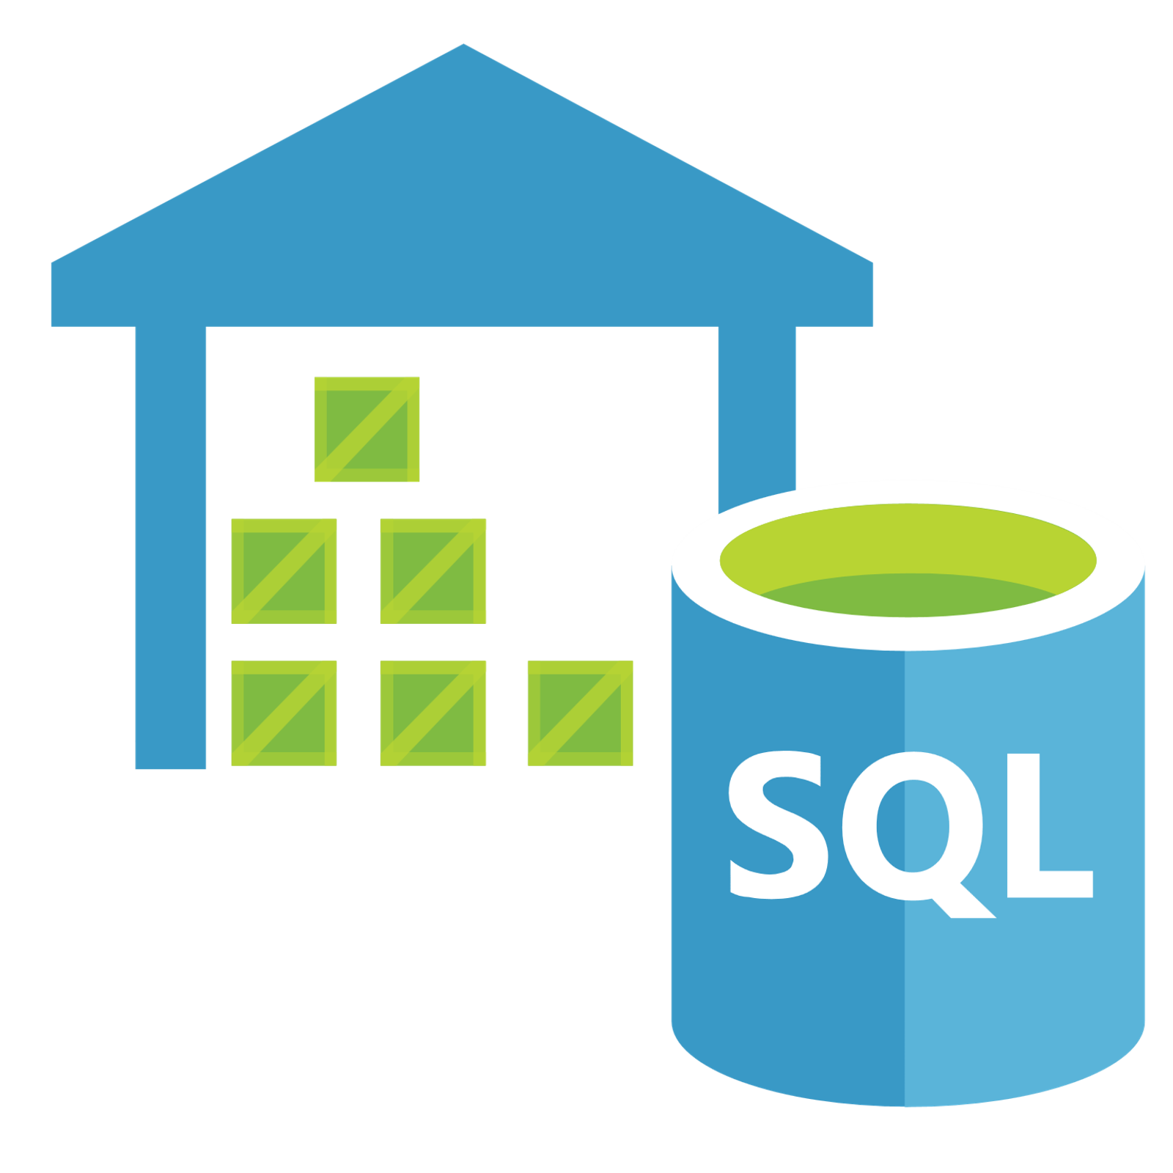



Azure Data Factory
Sources
Data Warehouse
Analysis
Reporting
ETL / ELT

Slide 9
Azure Data Factory
ETL / ELT
Visual UI
Drag and Drop
Code Support
Python, .NET, ARM
Control Flow
Loop, Branch, If
SSIS Execution
Lift and Shift

Slide 10
ETL / ELT

Slide 11
ETL - Extract Transform Load

Slide 12
ETL - Extract Transform Load

Slide 13

ETL - Extract Transform Load

Slide 14
ETL - Extract Transform Load

Slide 15
ETL - Extract Transform Load

Slide 16


ETL - Extract Transform Load

Slide 17
ELT - Extract Load Transform

Slide 18
ELT - Extract Load Transform

Slide 19
ELT - Extract Load Transform

Slide 20
ELT - Extract Load Transform

Slide 21
ELT - Extract Load Transform

Slide 22
ELT - Extract Load Transform

Slide 23

ETL
ELT

Slide 24
Azure Data Factory Concepts

Slide 25





Azure Data Factory Concepts
Pipelines
Activities
Triggers
Linked Services
Datasets
Integration Runtime

Slide 26
Preview of…?

Slide 27

Azure Data Factory Data Flows

Slide 28
Azure Data Factory Data Flows
ETL / ELT
Visual Authoring
Drag and Drop
Azure Databricks
No Code
Transform At Scale
Join, Split, Aggregate, Lookup, Filter, Sort, Derived Column

Slide 29
GitHub ADF piplines - https://github.com/Ratomir/ADFv2
Hive scripts – Hive.zip

Slide 30
Data factory documentation - https://docs.microsoft.com/en-us/azure/data-factory/

Slide 31

Pingvini moveaju datu

Slide 32


