Slide 2
Windows Systems Development
With a Linux touch
Edin Brodlic

Slide 3
Warning
This is not a cloud-based tale, I just liked the logo.

Slide 4
Introduction
What is NSoft about?
What is my team about?
What is this presentation about?

Slide 5
It all started out one lovely summer day…
A tale of big clients and runtimes on a deserted island

Slide 6
What can we do about it?
Active Directory
Chocolatey
SaltStack

Slide 7
Let’s make a package manager and port everything!

Slide 8
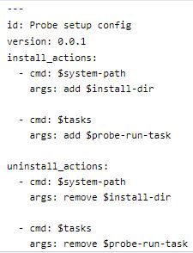
Probe
Based on .NET and C#
NuGet to the rescue
Using NSIS for initial deploy
setup.yaml as package descriptor
Tasks, directives, schedules

Slide 9
Forge
Python handling templates and NuGet/NSIS
Jenkins for inhouse building
Ansible for easy builder deploy

Slide 10
Nexus / Gateway
OSS Nexus with NuGet and raw repos
Gateway (NodeJS) API manipulation, groups/tags
Installation Profiles
bsdiff (bzip2) -> 50/90% size reduction

Slide 11
Varnish
RP - HTTP accelerator - Cache
VCL flexibility - auth/routing/ttl
varnishstat / varnishlog

Slide 12
As for the vision...
Build something I always wanted as a user
Introduce web profiles, upstreams
Make it live and configurable
See it all come together the Windows way
Push it into community

Slide 13
Unpleasantries
Release demand was high
Good vision support but not enough man-power
Port and runtimes complexity outweighed .NET rewrite benefits
Code smells and product-aware modules
High risk of critical outcomes, and troublesome client interventions
Ripping off RPM is a lot of anticipation and work :)

Slide 14
In the end...
Satisfactory production conditions ~ 2K devices and over 50 packages
No backend or deploy hiccups
Open Source plans on hold

Slide 15
The good parts!
Application Runtime Service was a blast!
Display Outputs, Window Management, User Sessions - PInvoke has you covered!
You get to see the results!

Slide 16
Demo
Murphy, it’s staging...

Slide 17
Conclusions
Workstations mesh well with anything C-like
Windows is cool if you like to dig
Wish more Linux or Mac practices get adopted

Slide 18
Drill me!
Or don’t.

Slide 19
The End

