Slide 1
Azure App Service
Web App for Containers
Admir Tuzović
CTO @ App Impact

Slide 3





About me
Chief Technology Officer
Author
Former Tech Evangelist
The Art of Speaking

Slide 4
Agenda
Short introduction to containers and Docker
Overview of Azure offerings for containers
App Service architecture
Demos

Slide 5
Expectations (Level 300)
ASP.NET / ASP.NET Core proficiency
Some experience with Microsoft Azure platform
Basic understanding of containers is helpful

Slide 6
Why Containers?
Deployment of runtime and dependencies with app
  Same environment expectations
  Platform limitations override
Better performance (deploy only what you need)
Faster delivery to customers

Slide 7
What is Docker?
Open source platform for containers
Secure, trusted by leading enterprises
Supported natively by Windows and Linux servers
Clients for Windows and Mac

Slide 8
Docker Image vs Docker Container
Image = template, containing multiple layers
Thin R/W layer
Container layers (R/W)
ubuntu: 15.04
54bd78ae9312
784eab9h521a
Image layers (RO)
f2h1aacb8d331
Container = executing instance created from image

Slide 9
Hosting
Physical Server
Hypervisor
VM 1
VM 1
VM 1
Windows OS
Linux
Windows OS
Docker Engine
Docker Engine
Docker Engine
App 1
App 2
App 5
App 6
App 9
App 0
App 3
App 4
App 7
App 8
App I
App J

Slide 10

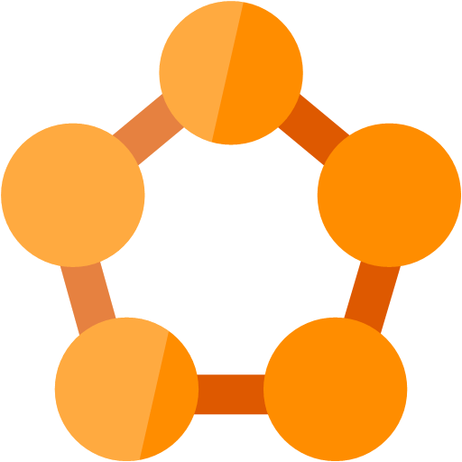


Containers/Microservices on Azure
Azure App Service
Azure Service Fabric
Azure Container Registry
Azure Container Service

Slide 11

Azure Service Fabric
App1
App2

Slide 12
App Service Characteristics
PaaS (Platform-as-a-Service) offering
Fully managed by Microsoft (patches, upgrades, etc.)
Horizontal (scale-out) and Vertical (scale-up) scaling by metrics (automated)
Billed on per-second basis
Integrated CI/CD
Deployment slots for seamless transition to new build

Slide 13
App Service Plan
App Service Plan (Basic / Standard / Premium / Isolated)
Instance 1
Instance 2
Instance 3
Web App 1
Web App 1
Web App 1
W3WP
W3WP
W3WP
W3WP
W3WP
W3WP
SLOT A
SLOT B
SLOT A
SLOT B
SLOT A
SLOT B
Web App 2
Web App 2
Web App 2
W3WP
W3WP
W3WP
W3WP
W3WP
W3WP
SLOT A
SLOT B
SLOT A
SLOT B
SLOT A
SLOT B

Slide 14


Web App - Variations
Web App
Windows OS
Bring your source code
.NET Framework 3.5/4.7
PHP 5.6 / 7.0-7.2
Python 2.7/3.4
Java 7/8
Web App
Linux OS
Bring your source code
.NET Core 1.0-1.1/2.0
PHP 5.6/7.0-7.2
Node.js 4.4-9.4
Ruby 2.3
Web App for
Containers
Bring your container
Docker Hub
Azure Container Registry
Private Registry

Slide 15
docker.com Pricing
Plan | Price | Private Repos
Free | $0 USD / month | 0
Micro | $7 USD / month | 5
Small | $12 USD / month | 10
Medium | $22 USD / month | 20
Large | $50 USD / month | 50
XLarge | $100 USD / month | 100
XX-Large | $250 USD / month | 250
XXX-Large | $500 USD / month | 500

Slide 16
Azure Container Registry Pricing
Tier | Storage | Web hooks | Price / day | Price / month
Basic | 10 GiB | 2 | $0.167 USD | $5 USD
Standard | 100 GiB | 10 | $0.667 USD | $20 USD
Premium | 500 GiB | 100 | $1.667 USD | $50 USD
Additional storage per GiB, only Standard and Premium Tier: $0.003 USD / day

Slide 17



Get started for free!
Account at www.docker.com (www.docker.io)
Docker client for Windows OS (Community Edition, latest 18.03.0-ce-win59 (16762).
Microsoft Azure Subscription (check out VSTS Dev Essentials)
Visual Studio 2017 (Community, latest 15.6.6)

Slide 18
Demo(s)
Publish to Web App for Linux from VS
Deploy to Web App for Containers from Docker Hub
Deploy to Web App for Linux from Azure Container Registry

Slide 19

Continuous delivery with remote builds
Visual Studio Team Services (VSTS)
Build
+
Tests
Release
Management
Commit/push to
version control
Build
&
Deploy
Write code
Web App
ACR

Slide 20






Evaluate Sessions & Win the Prizes

Slide 21





GatherUp! Event Management Platform
Focus on your event content instead of its organization.
Over 30 different features: Call for Speakers, Registrations, Ticketing, Agenda Builder, Built-in CRM and CMS, Session Evaluation, Mobile Apps for Attendees, Badge Maker, …
Clients that have placed their trust in us:
Share your feedback, ideas and interests with us!
info@appimpact.ba

