Slide 1
Enhancing PowerApps with Cognitive Services
Adis Jugo, skybow
MVP

Slide 2
Enhancing PowerApps with Cognitive Services
Adis Jugo
Director Product Technology, skybow
Microsoft MVP

Slide 3
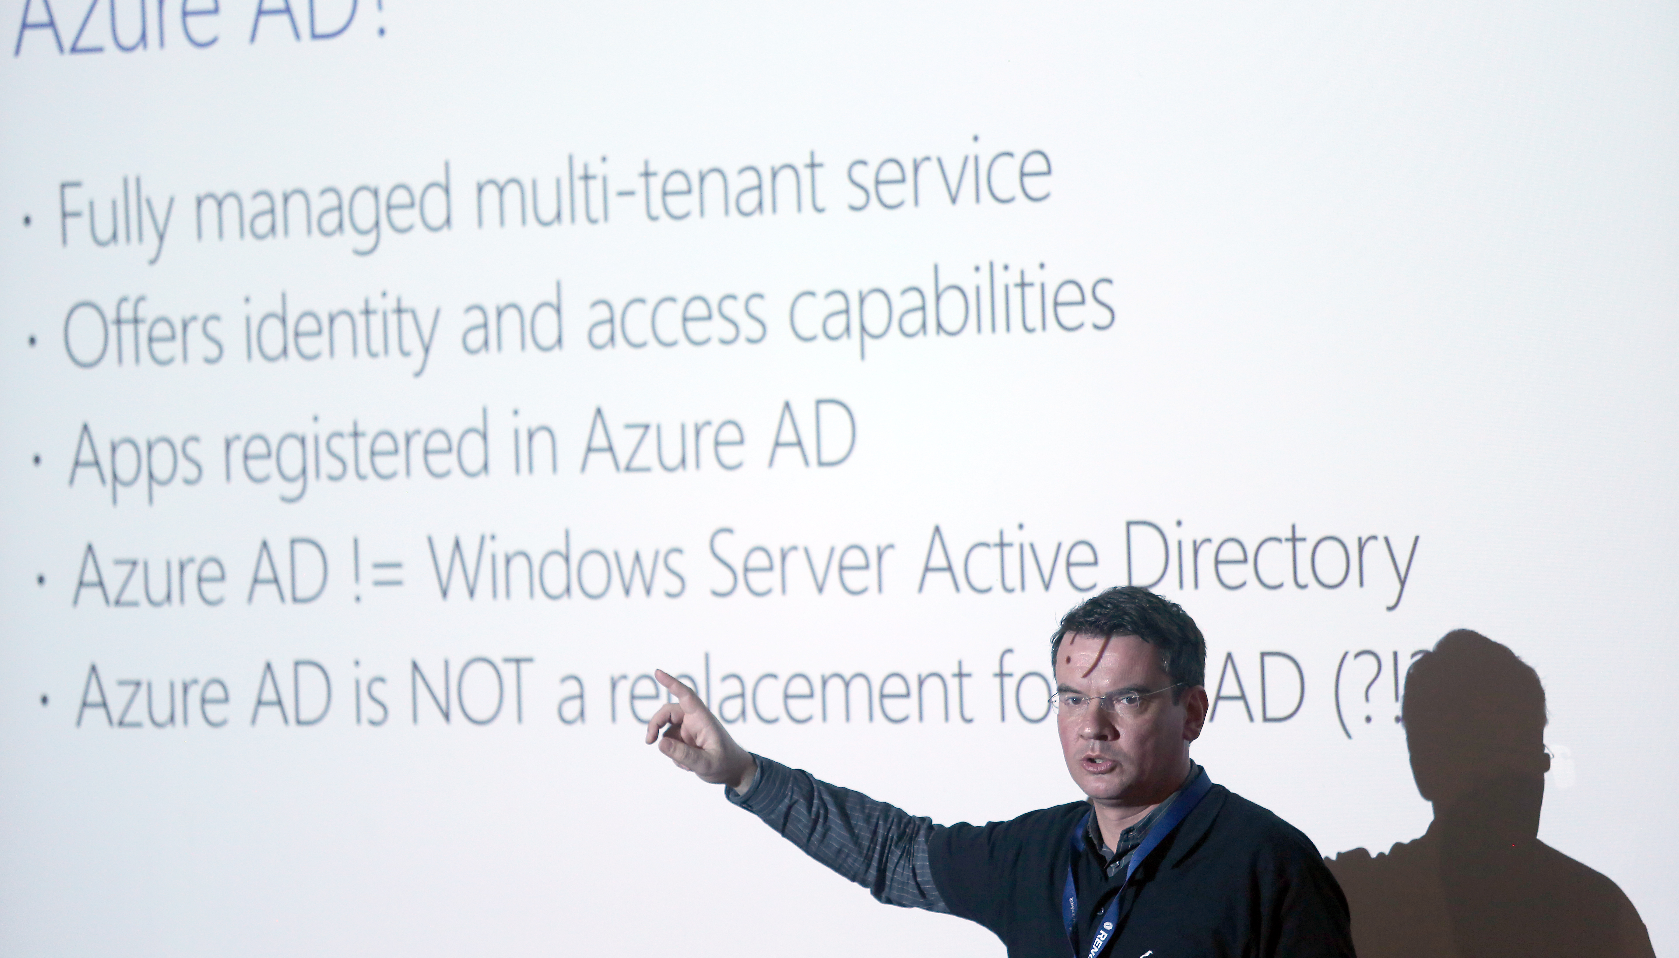
Adis Jugo
Microsoft MVP Office Development
Microsoft MVP Office Servers and Services
In IT for way too long (first money earned with development in 91)
Still dreaming of a Ćevapi restaurant or a vineyard
Director of Product Technology at skybow AG
Born in Sarajevo, B&H, living in Bingen, Germany
Blogger, speaker, author. adisjugo.com
Notes:
VS 2013 with console
VS 2013 empty
VS 2012 with WP emulator
SP Designer
Microsoft Azure (IE)
Win Dev Portal (IE)
Dev site (Chrome)

Slide 5
Agenda
What are PowerApps
Quick Intro
Connectors
Environments
What are Cognitive Services
Putting it all together

Slide 6

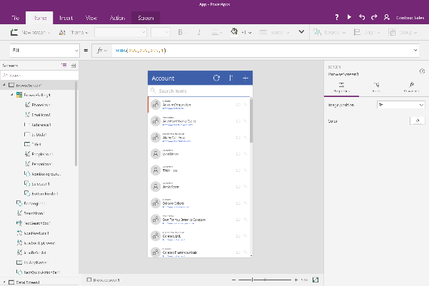
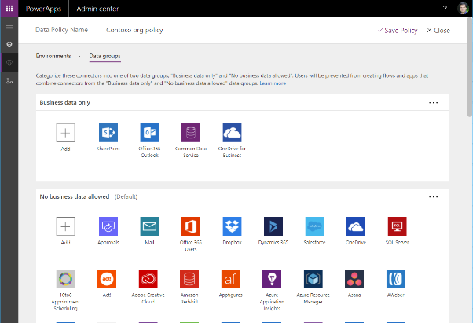
PowerApps - Easy Authoring
Truly WYSIWYG – full control over user experience, use it as you build it
Create app logic with familiar Excel-like expressions
Mash up data from multiple sources right at the app level

Slide 7
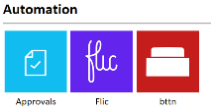
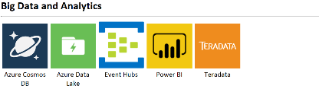
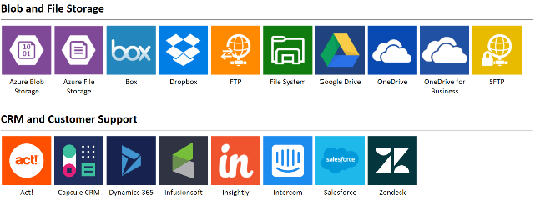
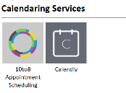
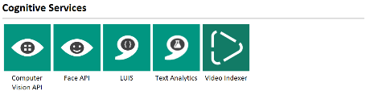
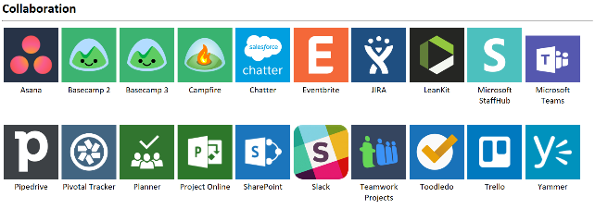
Connected data
Common data service provides a rich platform + standard model that gets creators instantly productive
Add 160+ connected data sources
Add custom connectors and on-premises sources

Slide 8
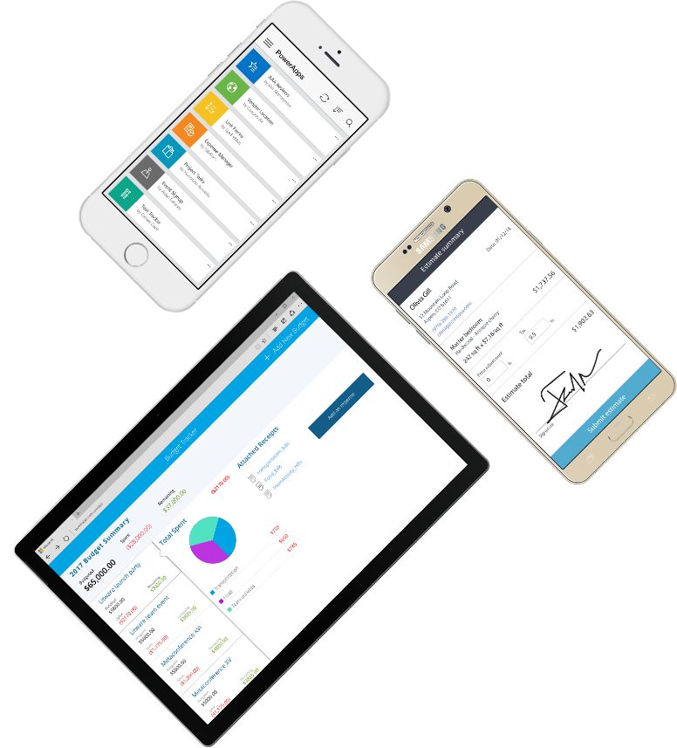
Cross-platform
Publish instantly to iOS, Android, Windows, and the web
Sharing apps is like sharing documents
Manage across environments

Slide 9

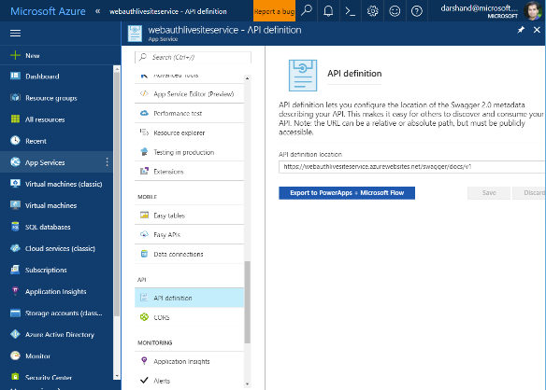

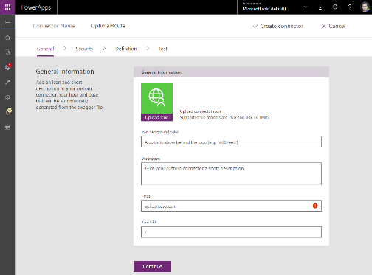
Pro developers welcome…
Build apps that go beyond what you get in the box
Build reusable custom app components & connectors
Leverage the full power of Azure capabilities

Slide 10
Demo
Creating a simple PowerApp

Slide 11






Microsoft Cognitive Services
Give your apps a human side
Vision
From faces to feelings, allow
your apps to understand
images and video
Speech
Hear and speak
to your users
by filtering noise, identifying speakers,
& understanding intent
Language
Process text and
learn how to recognize what users want
Knowledge
Tap into rich knowledge amassed from the web, academia, or your
own data
Search
Access billions of web pages, images, videos, and news with the power of Bing APIs
Labs
An early look at emerging Cognitive Services technologies: discover, try & give feedback on new technologies before general availability

Slide 12
Microsoft Cognitive Services
Give your apps a human side
Computer Vision
Content Moderator
Emotion
Face
Video
Video Indexer
Custom Vision Service
OCR
Bing Speech
Speaker Recognition
Translator Speech
Custom Speech Service
Bing Spell Check
Linguistic Analysis
Text Analytics
Translator Text
Web Language Model
Language Understanding
Academic Knowledge
Entity Linking
Knowledge Exploration
Recommendations
QnA Maker
Custom Decision Service
Bing Autosuggest
Bing Image Search
Bing News Search
Bing Video Search
Bing Web Search
Bing Entity Search
Bing Custom Search
Project Prague (gesture)
Project Cuzco (events)
Project Johannesburg (routing)
Project Nanjing (isochrones)
Project Abu Dhabi (distance matrix)
Project Wollongong (location)
Vision
Speech
Language
Knowledge
Search
Labs

Slide 13
Demo
Extending PowerApps with Cognitive Services

Slide 14
Hvala ☺
Pitanja?
@adisjugo

