Slide 1
Uvod u CNTK
Bahrudin Hrnjica,
@bhrnjica,
MVP VSDT

Slide 3
Agenda
What is CNTK
Intro to Neural Network
CNTK architecture
Getting Started with CNTK
  Demo how to prepare your machine to run CNTK
  Demos in Python and Visual Studio
  MINST Demo in .NET and C#
Running Object Detection Demo in Python
  Recognizing Nokia3310 legendary phone on image (transfer learning)
ANNdotNET – GUI tool for running CNTK (time series demo)

Slide 4
The Microsoft Cognitive Toolkit (CNTK)
Microsoft’s open-source deep-learning toolkit
  Relative easy of use (what, not how)
  Fast – leads competitors esp. GPU
  Flexible – easily be extended with: C++, C#, Python, R
  Scalable – multi-GPU, multi-server scale
1st class Windows and Linux support, MacOS(docker)
Internal (Microsoft)=external(World)
External contributors from MIT, Stanford, ..

Slide 5
Deep learning at Microsoft
Microsoft Cognitive Services
Skype Translator
Office
Cortana
Bing
HoloLens
Microsoft Research
Windows ML

Slide 6
Working with CNTK
CNTK can setup nearly any combination of Neural Network, NN:
  Feed Forward NN
  Deep Feed Forward NN
  Recurrent NN
  Convolutional NN

Slide 7
Tensor- CNTK building block
Tensor - an n- dimensional matrix
3 - rank 0, shape = [1]
[1,2,3,4] - rank 1, shape [4]
[[1,2,3],[4,5,6]] -rank 2, shape[2,3]
[[[1,2,3]],[[7,8,9]]] - rank 3, shape [2,1,3]
[[[1,2,3],[4,5,6]] , [[7,8,9], [10,11,12]]] -rank 3, shape [2,2,3]

Slide 8
What is ANN
Network Design
Activation Function
Loss Function
Overfitting
Features (number of input parameters)
Label (one hot vector)
Network parameters
Training parameters
Enable non-linear models:
Softmax, tanh, ReLU
Measure the performance during training.
Cross-Entropy, Square Error
Trainer
Optimization process which purpose is to calculate weights based on backpropagation.
SGD, Adam,…
Stop model from over-optimizing on training data set.

Slide 9
4 Steps in building prediction model
Build
Train
Test
Predict
Providing data, defining input and output, network and training configuration
Use training data set to build NN model, often 70% of provided data
Use your remaining data set (30%) to validate NN model.
Once training and evaluation process are successfully done, use the model in production, to make prediction.

Slide 10
CNTK Architecture
CNTK
READER
task specific de-serializer
automatic randomization
Network
Network definition
CPU/GPU execution engine
Learner
SGD (momentum, AdamGrad,…)
Mini-batching, packing, padding
data
model

Slide 11
Top Level Configuration
Input dimension
Output dimension
Data reader type
Samples number
Minibatch size
Epoch ~ iterations * (SampleNumber/ Minibatch size )
Network Creation
Training Type

Slide 12
Getting Started wit CNTK
How to Install CNTK for Python and .NET
Run Simple Demo in Python and C# - https://github.com/bhrnjica/cntk-examples

Slide 13
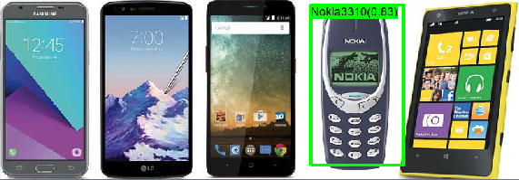
DEMO 02: Doing Real Stuff with CNTK https://github.com/bhrnjica/ObjectDetection

Slide 14
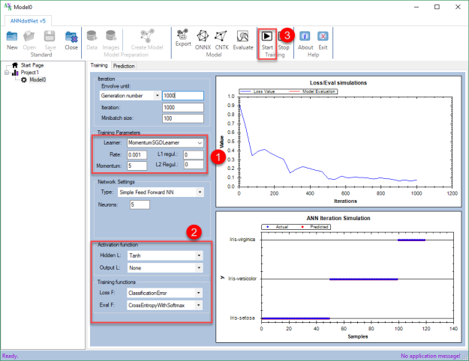
DEMO 03: ANNdotNET – GUI for CNTK https://github.com/bhrnjica/anndotnet

Slide 15
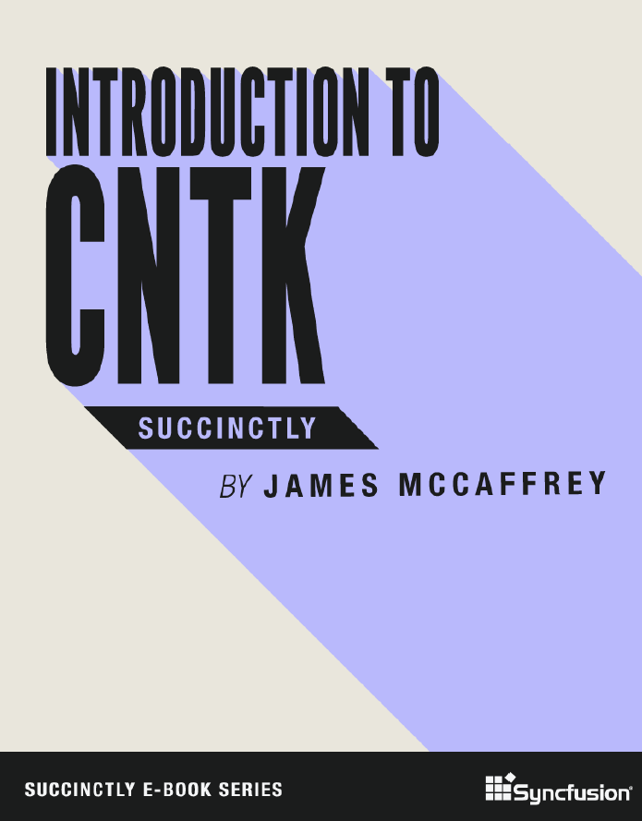
CNTK references
FREE BOOK: https://www.syncfusion.com/ebooks/cntk_succinctly
http://github/microsoft/cntk - CNTK on GitHub
https://docs.microsoft.com/en-us/cognitive-toolkit/ - CNTK documentation
https://github.com/bhrnjica/cntk-examples CNTK demos in C# and PY
https://github.com/bhrnjica/ObjectDetection Nokia3310 Py sample
http://bhrnjica.net/anndotnet - GUI tool for running CNTK,
https://github.com/bhrnjica/

Slide 16
Q&A

Slide 18
CNTK reader- getting your data into CNTK
Verbosity
Randomization
Input type
Files or in memory data
Input (features)
Output (label)
Automatic randomization important for large datasets
Readers compose, e.g. image-> text caption

Slide 19
CNTK reader- getting your data into CNTK
Standard formats: images, speech (HTK, Kaldi)
Converts to CNTK Text format
Big data: implement custom deserializer in C++ or Python
Small data: read data in memory

Slide 20
Hot to: network
Network specification consists of:
  The network function’s formula
    Including learnable parameters
    (but no gradients, which are automatically determined by the system)
  Inputs
  The output(s) and training/evaluation criteria
Network descriptions are called “brain scripts”
  Custom network description language “BrainScript”
  CNTK API written in C++, Python, C#, R, Java

Slide 21
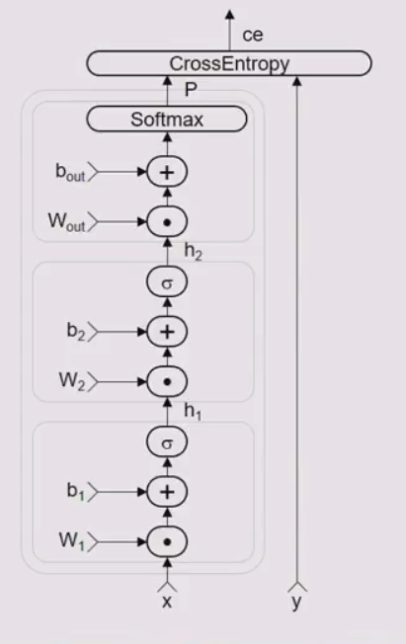
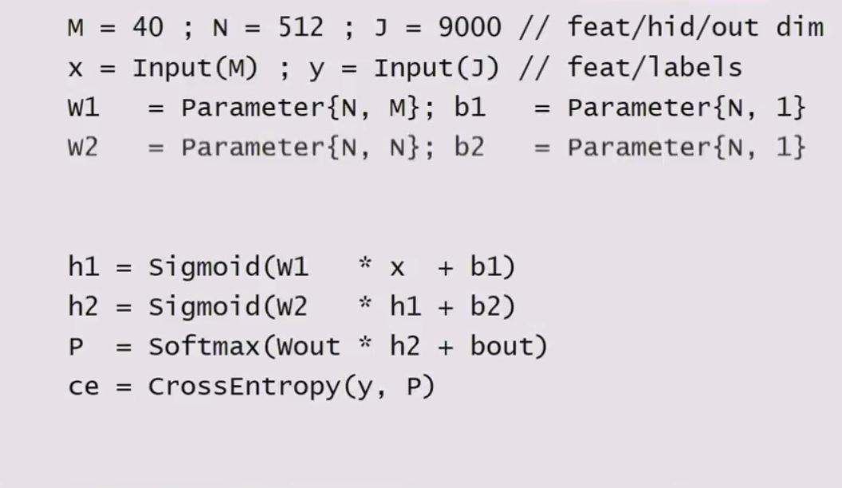
How to networks:

Slide 22
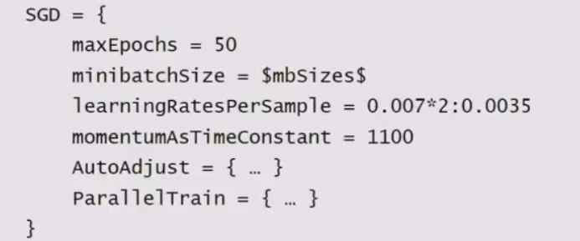
How to learner
All learning parameters at a glance
Various SGD variants (momentum, Adam, ..)
MB-size agnostic learning rate and momentum
Auto-adjustment of learning rate and minibatch size
Multi-GPU/multi-server parallelisation

Slide 23
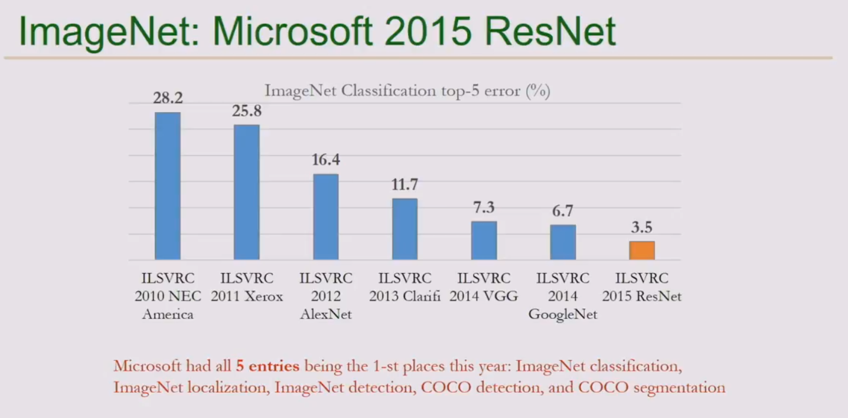

Slide 24
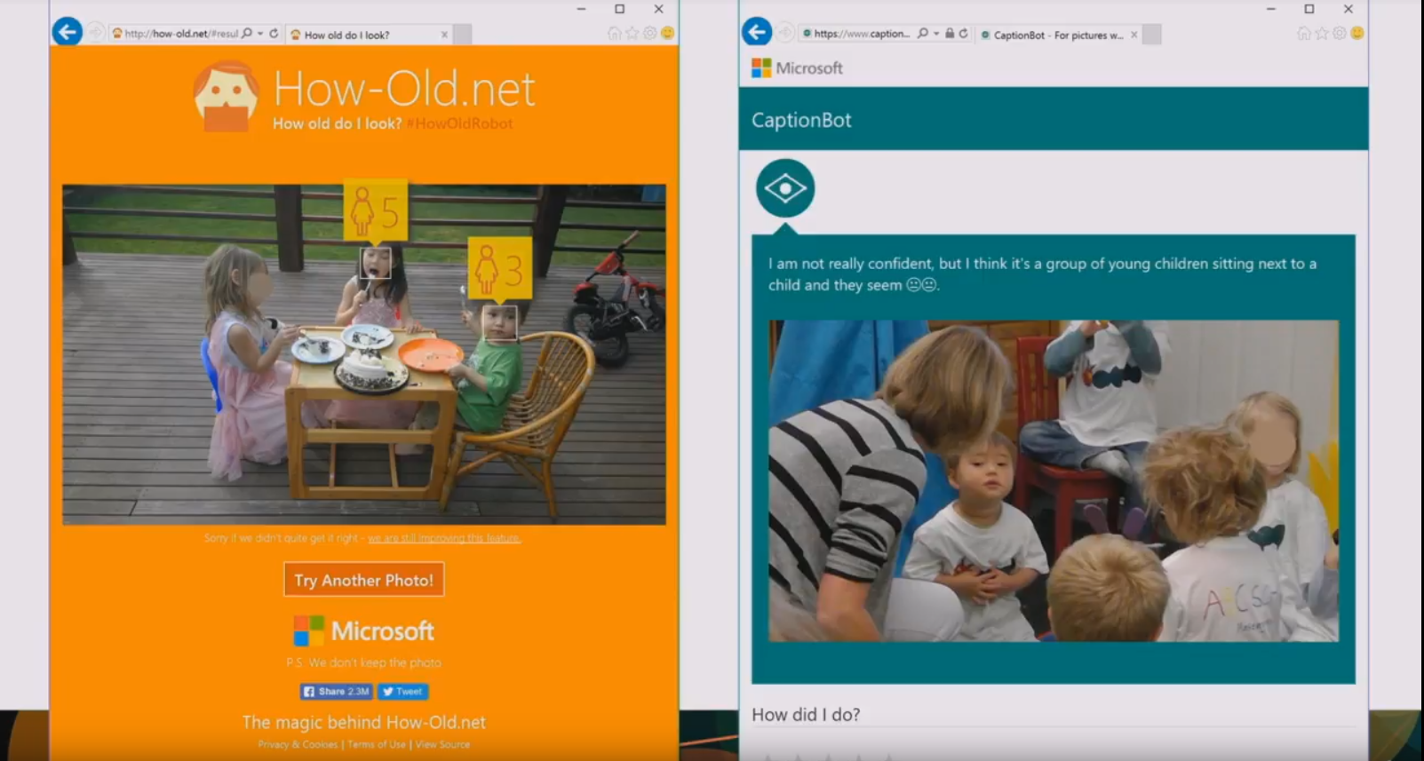

Slide 25
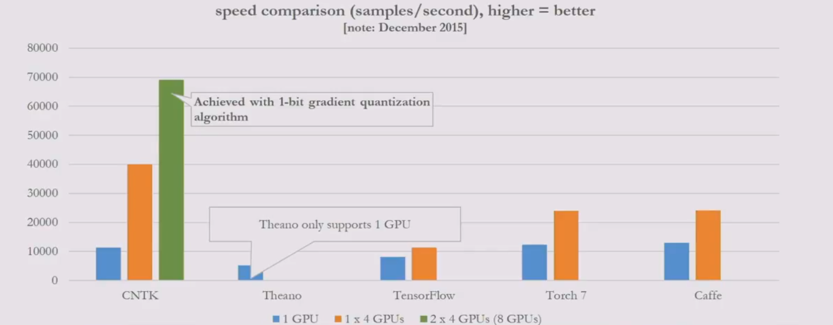
3. CNTK is production-ready: State of the art accuracy, efficient, and scales to multi-GPU/multi-server.

