Slide 1
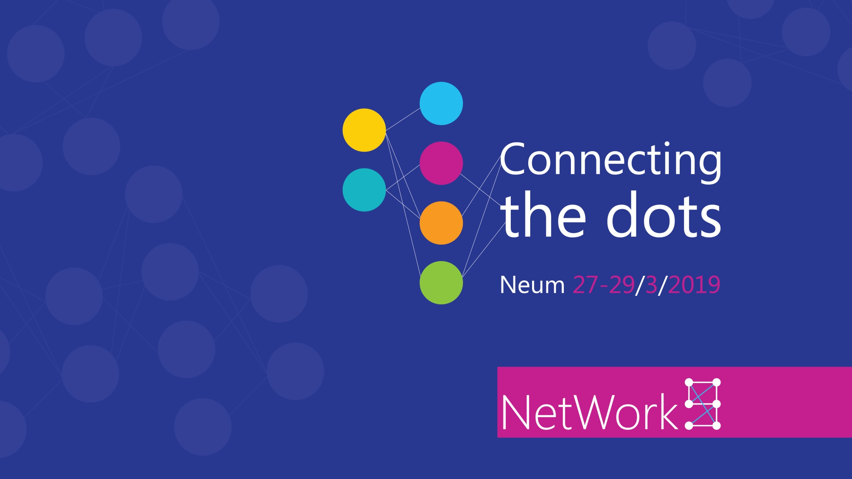
Vladimir Stefanović
Superadmins

Slide 2

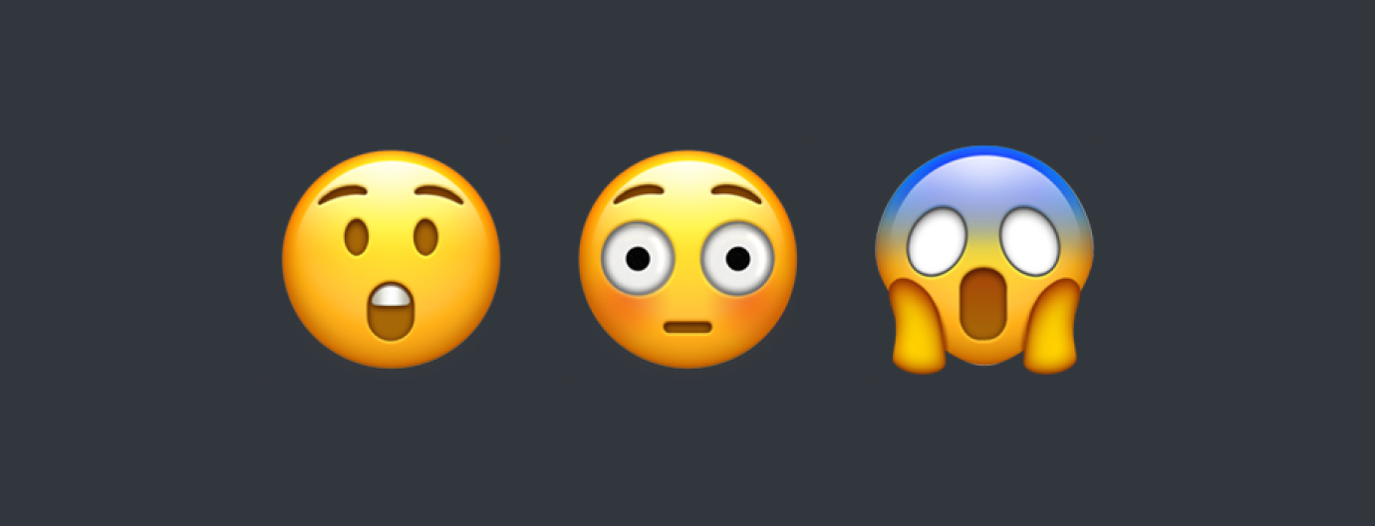
The most common mistakes in Azure projects

Slide 3
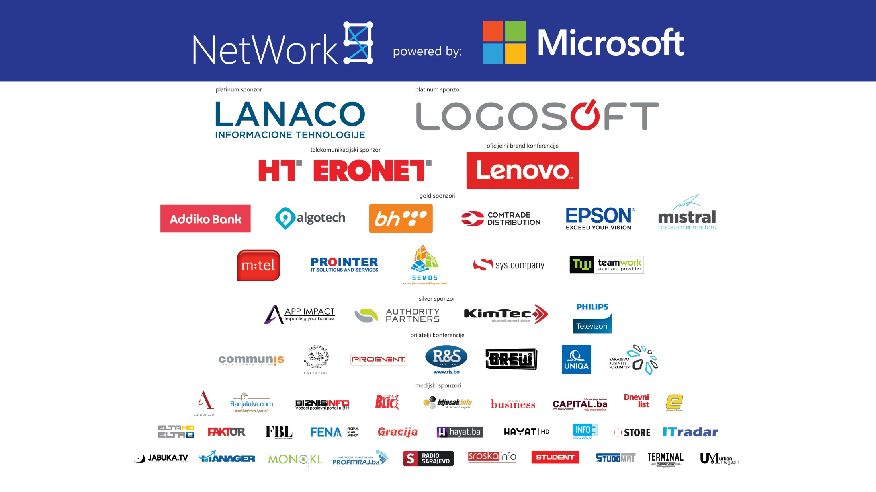

Slide 4

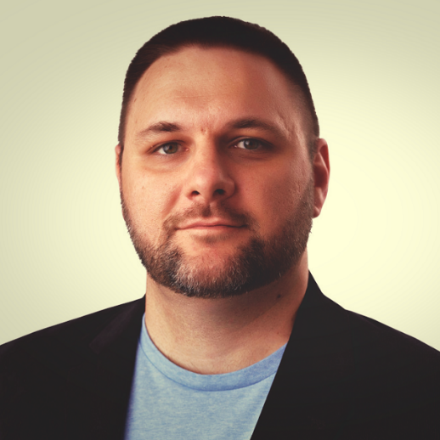
Who am I
Vladimir Stefanović
System Engineer, 10+ years of experience
MCT, MCSA, MCSE, Azure, Office365, Network & Security ...
Book author, conference speaker, technical trainer and Azure UG Leader
stefanovic.vladimir@hotmail.com
@Wladinho31
www.tech-trainer.info

Slide 5
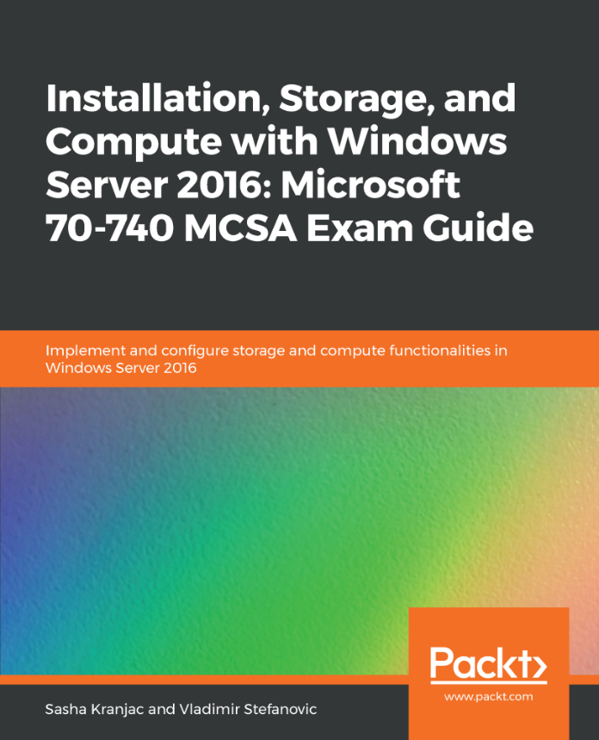
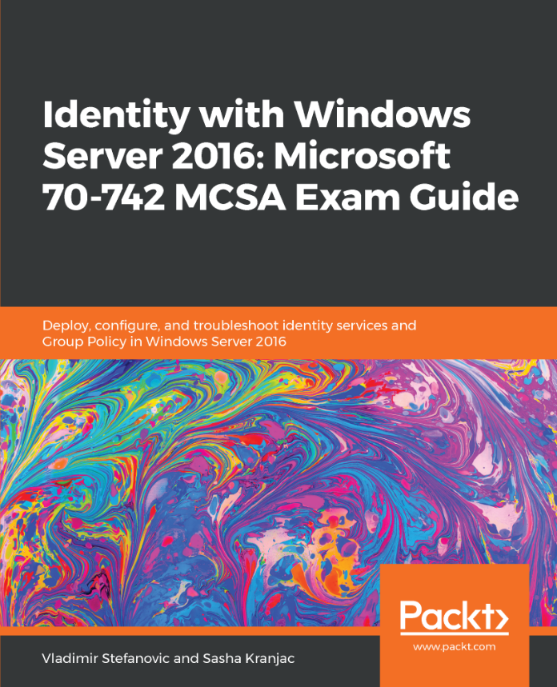
Book discount
40% Discount
ISCWS40
70-741
MCSA Exam Guide
Coming soon!

Slide 6
Agenda
IaaS mistakes
Networking mistakes
PaaS mistakes
Security mistakes
General
NOTE: All situations and cases appearing in this work are real.

Slide 7
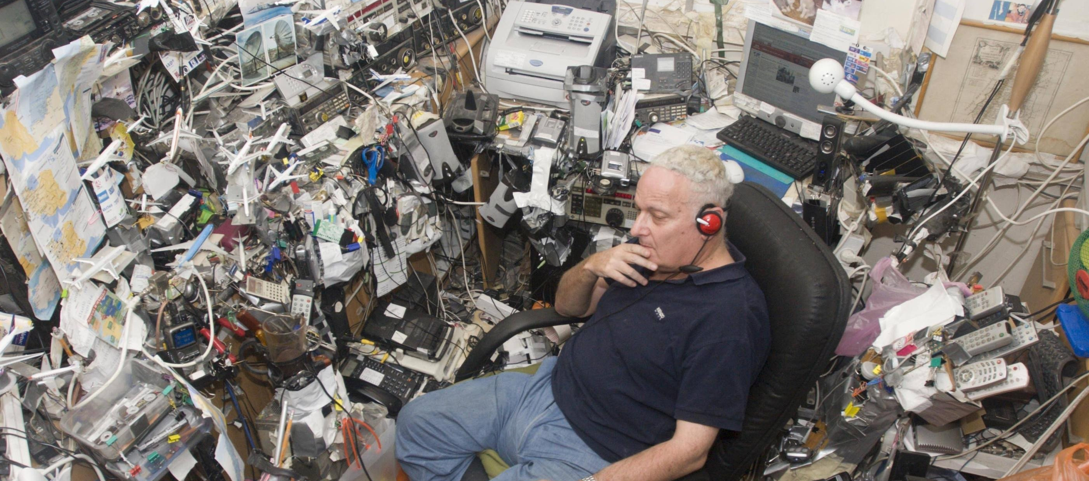
Don’t make Azure like this one ☺

Slide 8
IaaS Mistakes
Creating availability set and availability zone
  Cannot be added to virtual machine once is created
General understanding of virtual machine sizing
Pricing of virtual machine OS disk
  Is not counted to virtual machine price
Configuring static IP addresses in virtual machines
Virtual machine vNet changing is not possible
Trying to establish communication between virtual machies over public IP address

Slide 9
Networking Mistakes
vNet address space has same prefix as subnet
  This can be a big problem, but fortunately prefix can be changed
vNet name cannot be changed
Subnet address space and name cannot be changed
Network Security Groups
  Per VM or per group of VMs?
Public IP addresses
  Do we really need public IP address on each virtual machine?
  Alternatives are Jump Box, Azure Load Balancer NAT rules or S2S VPN

Slide 10
PaaS Mistakes
Using single database instead elastic pools
Creating new databases using SSMS
  All databases created using SSMS will be created as a Single Database
Azure Database for MySQL tier
  Changing to and from the Basic pricing tier after server creation is not supported
Enabling service endpoint instead of trying to add IP addresses to firewall rules

Slide 11
Security Mistakes
Inapropriate permissions
  To many users are owner or contributor on subscription
  To many global admins
Network Security Group offers you a warm welcome
  RDP and SSH ports are opened from internet
Backup is not included to IaaS by default

Slide 12
General Mistakes
General ignorance of Azure – The biggest one problem
  RBAC model
  Difference between subscription, account and resources
Naming convention
Misunderstanding regaring pricing models
  Per hour, per minut, per service
  Network bandwidth

Slide 13
