Slide 1

Machine Learning Algorithms as
Cloud Service for Network attacks
Indira Avdagić
Registar vrijednosnih papira u FBiH

Slide 2
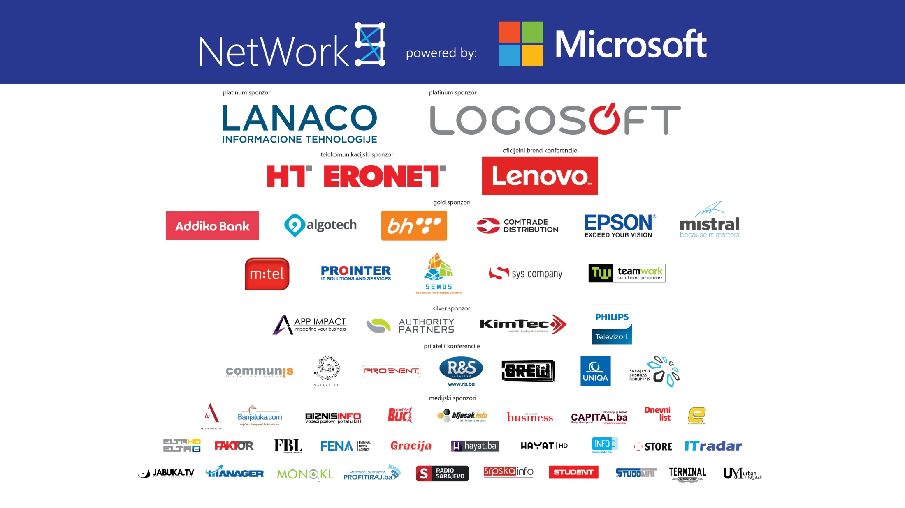

Slide 3

NetWork 9
My goal
Internet
Client
1. Internet comunications
2. Log data
investigation
5. Access to alerts and intelligence
3. Critical findings
Security Operation Center (SOC)
Log analytics
Anomaly detection
Security portal
Reporting and escalation
4. False positive
reduction

Slide 4

CIA for Clouds
  ieeexplore.org
Description of IDS, IPS, CIDPS
Framework proposal
  Technology
  Methodology
Conclusion and ideas for further work

Slide 5

  1961. John McCarthy
  „... public utility computing ...”
  2006. Elastic Compute Cloud,
  2009. App Engine,
  2010. Azure,
  IBM, Oracle, Intel, ...
  IaaS, PaaS, SaaS
  ... BPaaS, CPaaS, MLaaS, ...

Slide 6


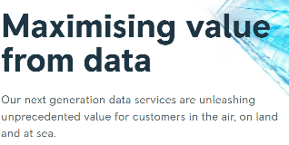
NetWork 9
Cloud Computing + IoT + Big Data Intelligence
Boeing 787 generates 500 GB per flight
            CIA for Cloud

Slide 7
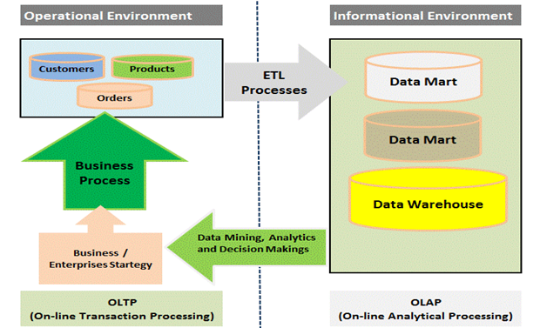
NetWork 9
http://www.sql-datatools.com/2015/08/dw-oltp-vs-olap.html

Slide 8
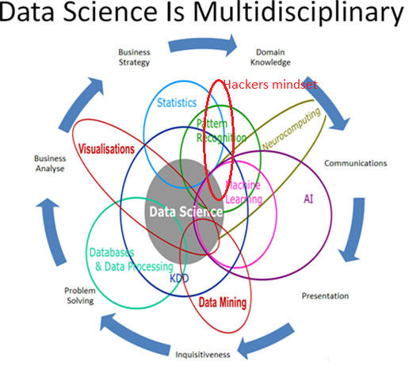
https://www.oralytics.com/2012/06/data-science-is-multidisciplinary.html

Slide 9

Big Data Analytics for Network Intrusion Detection: A Survey
  Conventional technologies cannot support long-term and large-scale analytics
An Intrusion Detection System Based on Hadoop
  Combination Hadoop cluster and improved K-Means to form distributed IDS to handle massive invasion of datasets
An Intrusion Detection Model based on DBN
  Deep Belief Network vs Support Vector Machine and Artificial Neural Network

Slide 10
Cloud IDPS
Distributed and scalable cloud environments
processing power,
cloud storage,
big data analytics to create predictions

Slide 11
IDPS
NetWork 9
  Network
  Host
  Hybrid
Anomaly Detection | Misuse Detection
Deviation from normal usage patterns/baseline | Patterns of known attacks (signatures)
Has to study sequential relation between steps/transactions. Need to be adoptable. False positives. | Known attacks have to be „hand-coded”. Unable to detect new attacks. Need signatures update. False negatives.

Slide 12
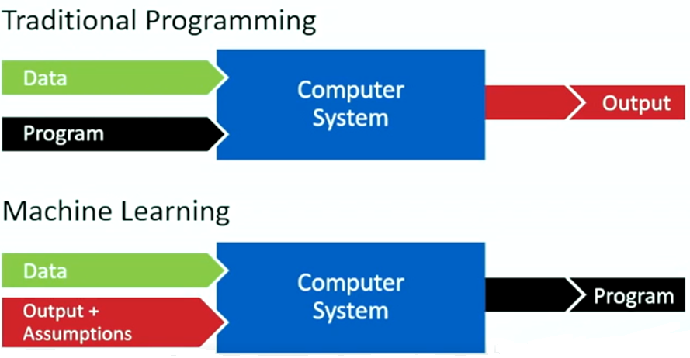
NetWork 9
https://www.rsaconference.com/videos/machine-learning-and-the-cloud-disrupting-threat-detection-and-prevention, lecture prof. Domingos

Slide 13
MLaaS
Azure Machine Learning Studio
Blob storage (NSL-KDD)
Supervised network attack detection
Classification technic
Web service

Slide 14
NSL-KDD dataset improved KDDCUP 99
Basic features attributes of individual TCP connection (duration, protocol_type, service ...)
Traffic features computed attributes (dest_host_count, same_srv_rate, ...)
Content features attributes suggested by the domain knowledge (num_failed_logins, logged_in, su_attempt, is_guest_login, ...)

Slide 15
NSL-KDD
Attack Class | Attack Type
DoS | back, land, neptune, pod, smurf, teardrop, ..
Probe | satan, Ipsweep, nmap, portsweep, ...
R2L | guess_password, ftp_write, imap, warezmaster, warezclient, phf, multihop, spy...
U2R | buffer_overflow, loadmodule, rootkit, perl, ...
Microsoft Azure Machine Learning: Algorithm Cheat Sheet

Slide 16
NetWork 9
Metodology
  KDDTrain (125973 feature’s vectors)
  KDDTest (22544) + 15 novel attacks (worm, sqlattack, mscan...)
  Experiment:
    Import labeled dataset
    Train Model -> Trains a classification model with supervised manner
    Score Model -> Scores predictions for a trained classification model
    (inputs: Train Model and KDDTest dataset)
    Evaluate Model -> Evaluates a scored classification model with standard metrics

Slide 17
Experiment
  Dataset with 41 features
  Evaluate Binary Classification Models

Slide 18
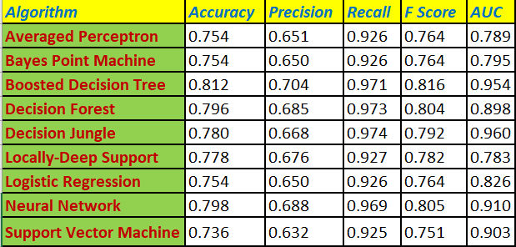
NetWork 9
  KDDTrain (125973 feature’s vectors)
  KDDTest (22544) + 15 novel attacks (worm, sqlattack, mscan...)
  Experiment:
    Import labeled dataset
    Train Model -> Trains a classification model with supervised manner
    Score Model -> Scores predictions for a trained classification model
    (inputs: Train Model and KDDTest dataset)
    Evaluate Model -> Evaluates a scored classification model with standard metrics

Slide 19
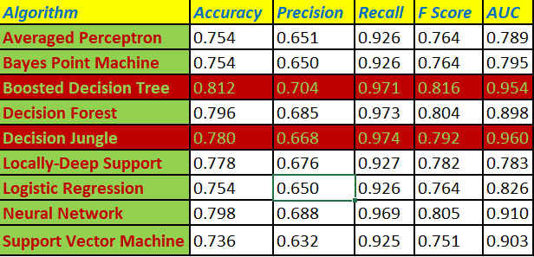
NetWork 9

Slide 20
2. Experiment
  Evaluate Boosted Descision Tree and Descision Jungle model with filtered 15 features
      Pearson Correlation feature scoring method to identify the features in a dataset with the greatest predictive power for label

Slide 21

NetWork 9

Slide 22
3. Experiment
  Creating predictive cloud web service with Boosted Decision Tree algorithm

Slide 23
Conclusion
The goal of this work was to propose a framework for the detection and prevention of network attacks in cloud systems with combination of ML algorithms through cloud service.

Slide 24
Future work
  new datasets (UNSW, ISOT)
  Unsupervised ML algorithms (Clustering, Deep Learning)
Creating a hybrid framework for detecting attacks and protecting the cloud systems in real time with small number of false predictions.

Slide 25
Thank you for your attention.
Questions ?

Slide 26


