Slide 1
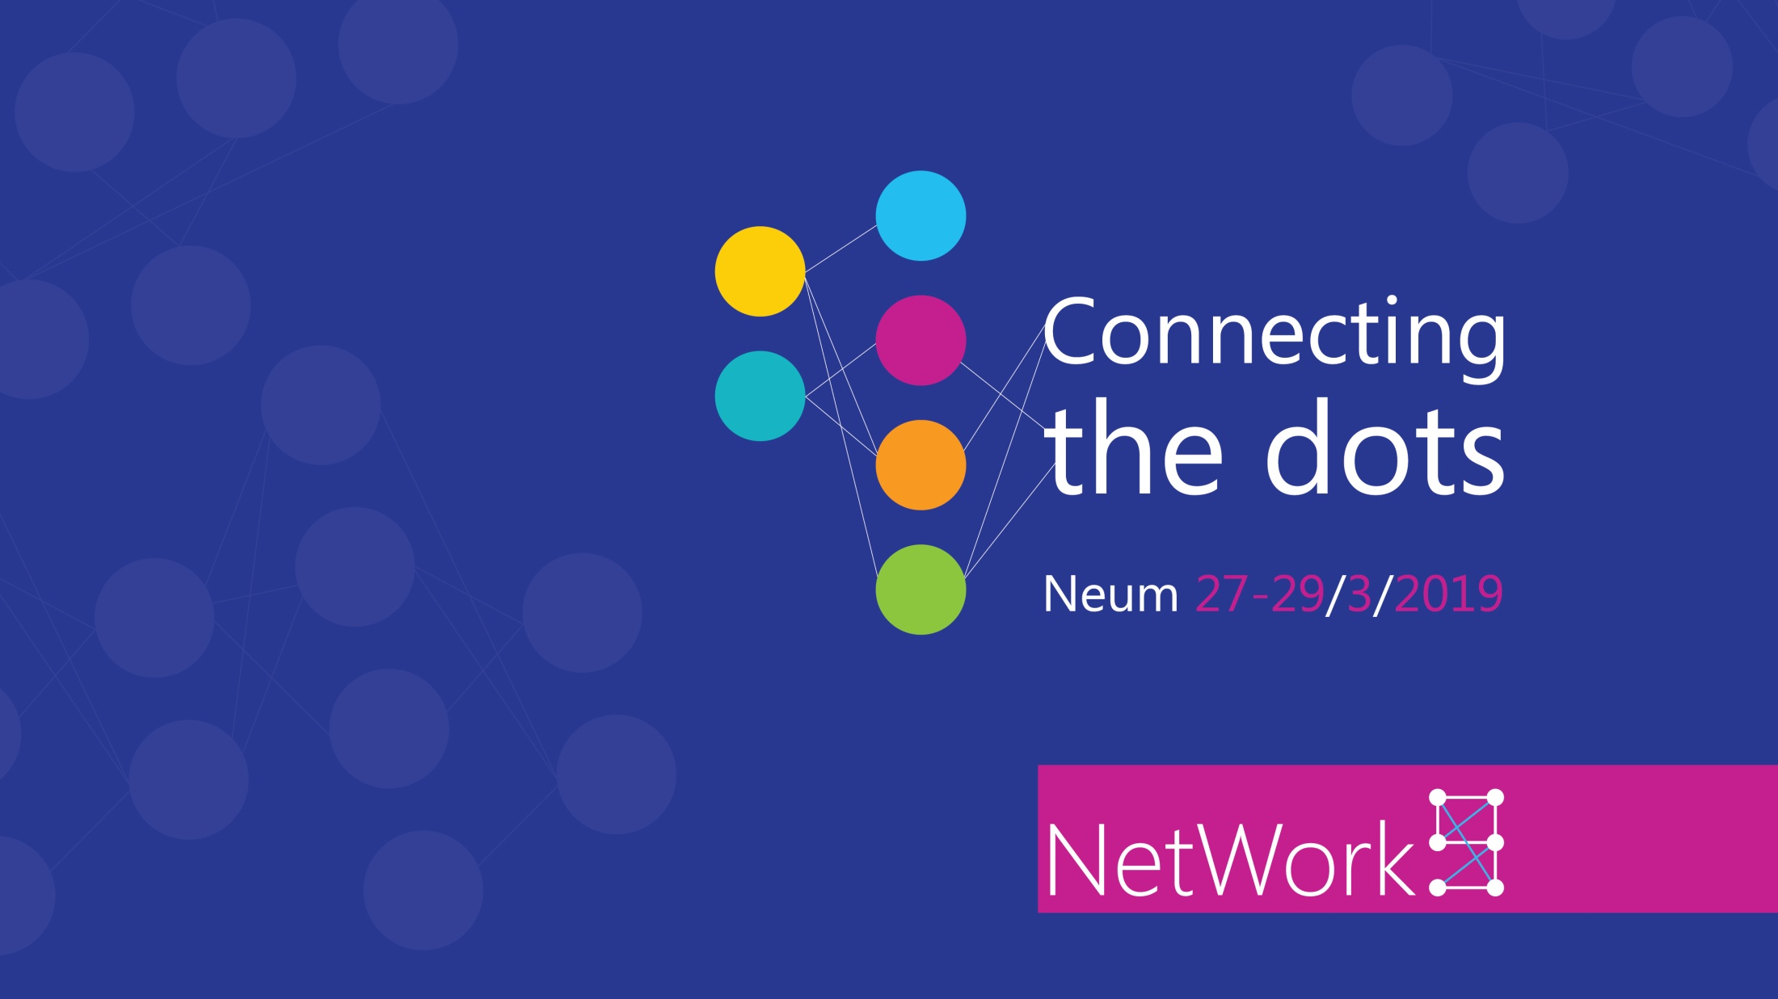
Igor Đerman

Slide 2
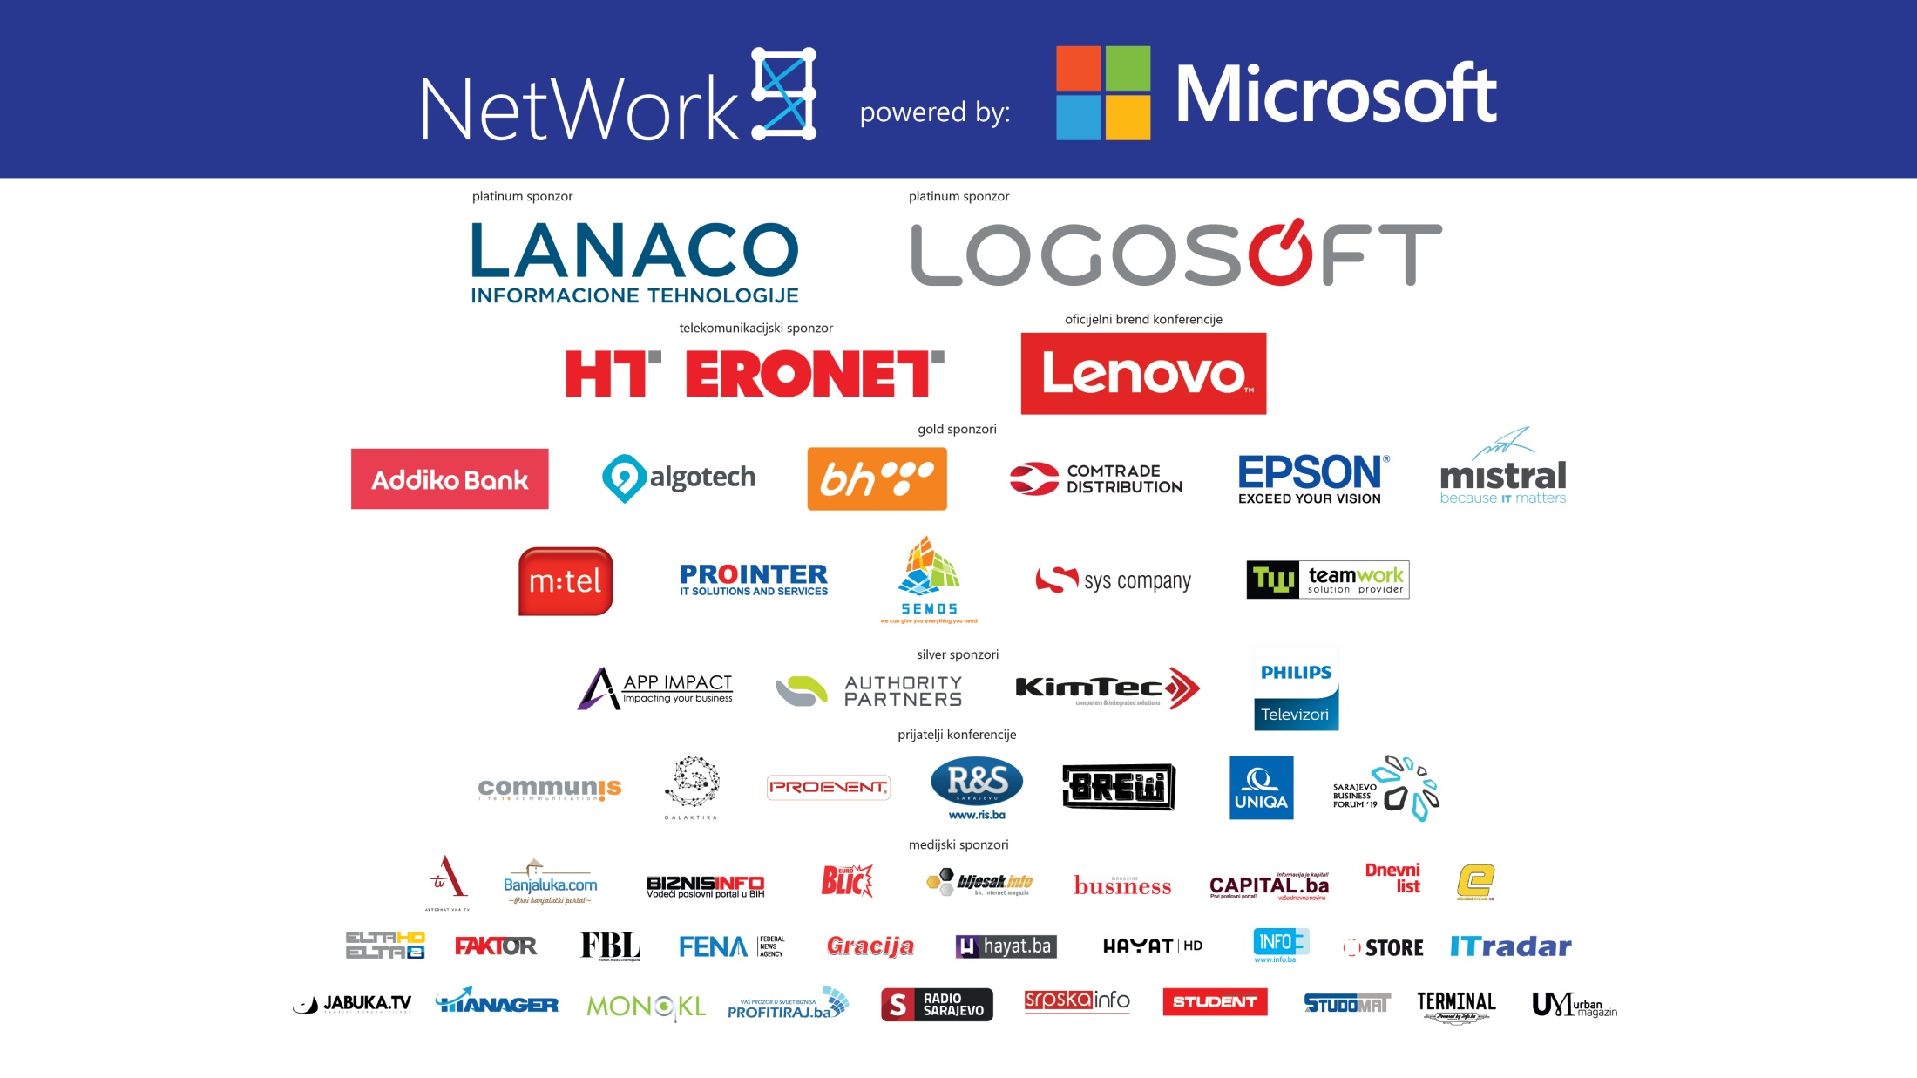

Slide 3

Building Hyperledger on Azure

Slide 4

Agenda
Blockchain
Hyperledger
Azure Setup
Conclusion

Slide 5
Blockchain
growing list of records, called blocks, which are linked using cryptography
programmed to record not just financial transactions but virtually everything of value

Slide 6

Concepts?
Transactions
Immutable ledgers
Decentralized peers
Encryption processes
Consensus mechanisms
Smart Contracts (Chaincode)

Slide 7

Transactions
historical archive of decisions and actions taken atomic
use cases: audits, distribution, personal identifications …

Slide 8
Immutable
the transaction is, immutable, or indelible
write and read
error would be resolved with another entry

Slide 9
Decentralized Peers
Decentralized peer to peer network
Each node has a copy of the ledger

Slide 10
Encryption
all blocks are encrypted
some Blockchains are public, some are private

Slide 11
Consensus
ensures that the next block in a blockchain is the one and only version of the truth
many Consensus mechanisms, each with pros and cons
can be unique
Proof Of Work, Proof Of Stake, Proof-of-authority …

Slide 12
Smart Contracts
Code
Provides business logic layer prior to block submission

Slide 13
Capabilities
shared ledger technology allowing any participant in the business network to see the system of record (ledger)
ensuring appropriate visibility; transactions are
secure, authenticated & verifiable
all parties agree to network verified transaction

Slide 14
Frameworks?

Slide 15
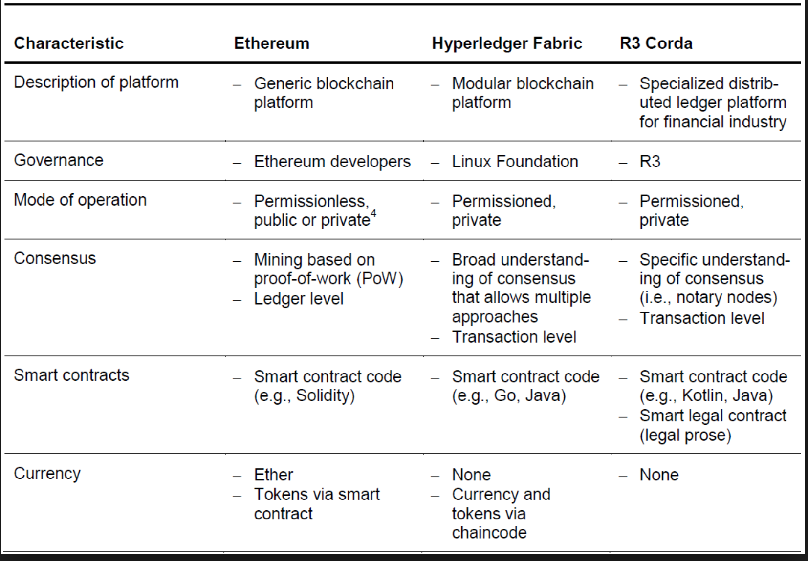
Frameworks?

Slide 16
Hyperledger
product of The Linux Foundation
create a blockchain specifically for the
enterprise community

Slide 17
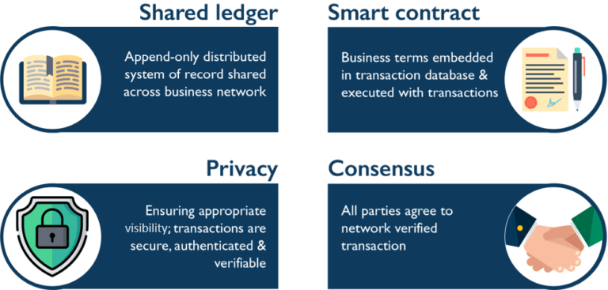

Slide 18
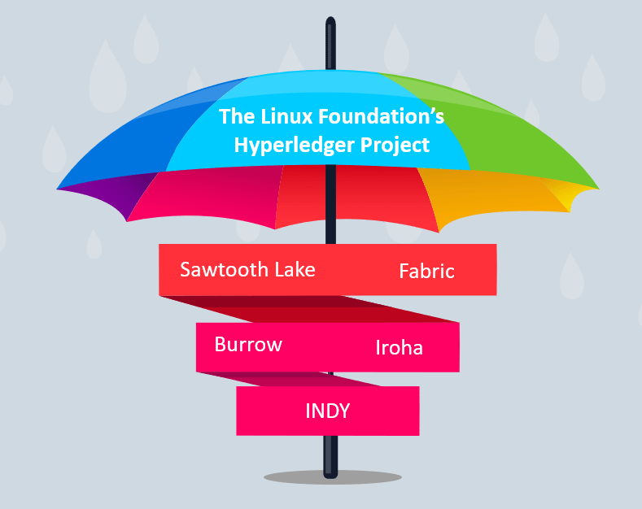

Slide 19
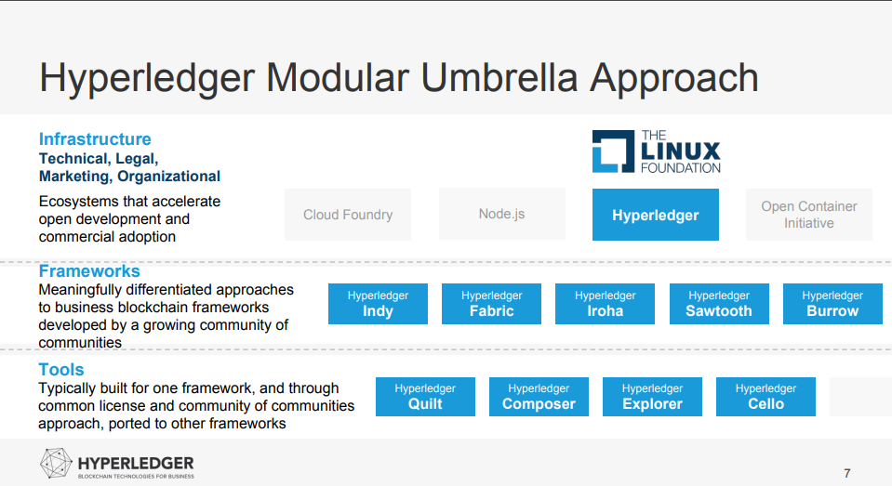

Slide 20
Composer
Explorer

Slide 21
HYPERLEDGER FABRIC

Slide 22
Differences
permissioned
pluggable consensus protocols
smart contracts authored in general-purpose programming languages
low latency
private channels

Slide 23
Members
Peers (configured with cryptographic materials)
Peers receives transaction invocation requests from the clients via REST or SDK
Chaincode installed in peers causes to initiate transaction invocation request

Slide 24
Endorser peer (Endorsing policy)
Anchor peer
Orderer peer (Solo, Kafka)

Slide 25
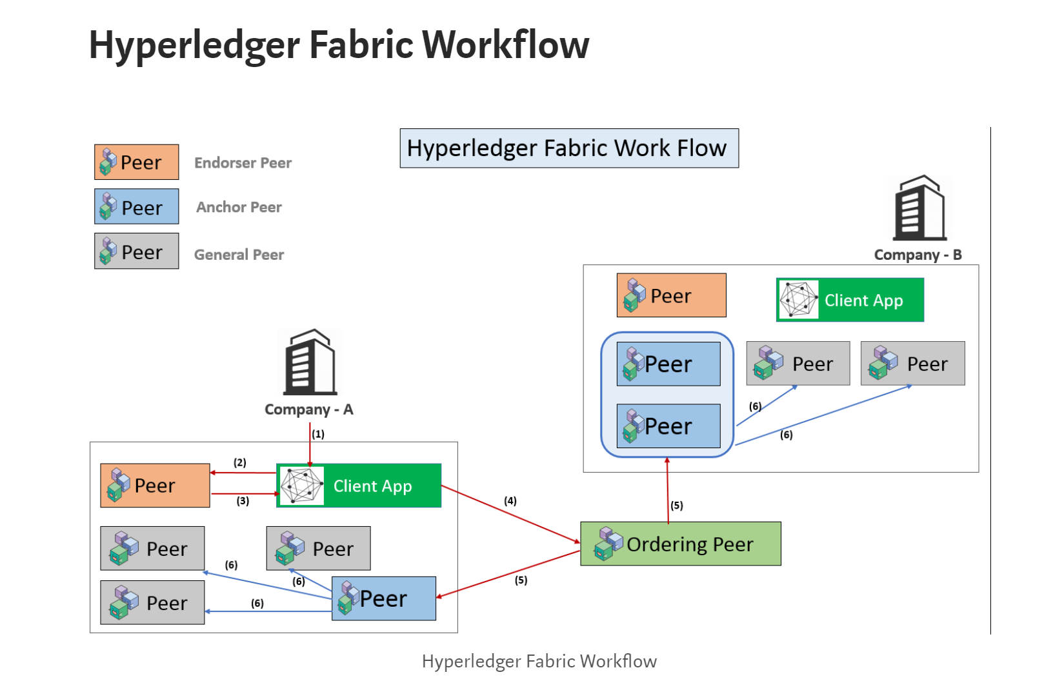
Endorser peer (Endorsing policy)
Anchor peer
Orderer peer (Solo, Kafka)

Slide 26
HYPERLEDGER FABRIC on Azure

Slide 27
updated template for Hyperledger Fabric 1.3
announced support for this popular offering through the Azure Marketplace

Slide 28
Solo, kafka
DB (Level, Couch)

Slide 29
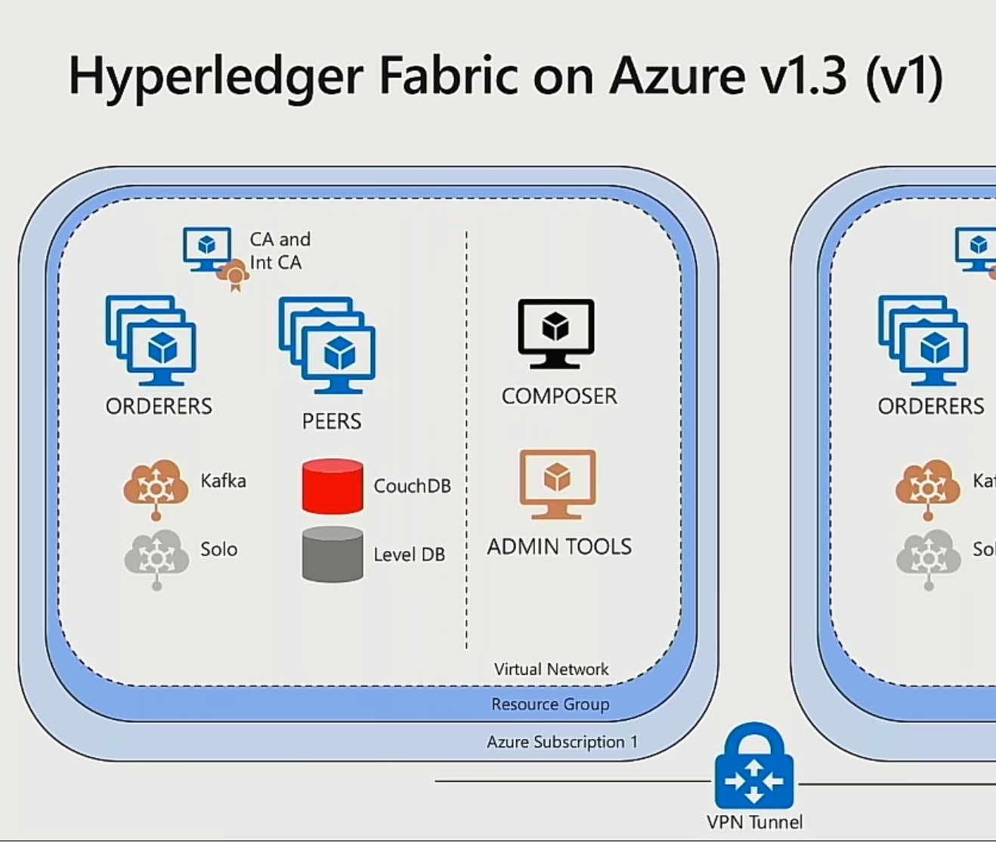

Slide 30
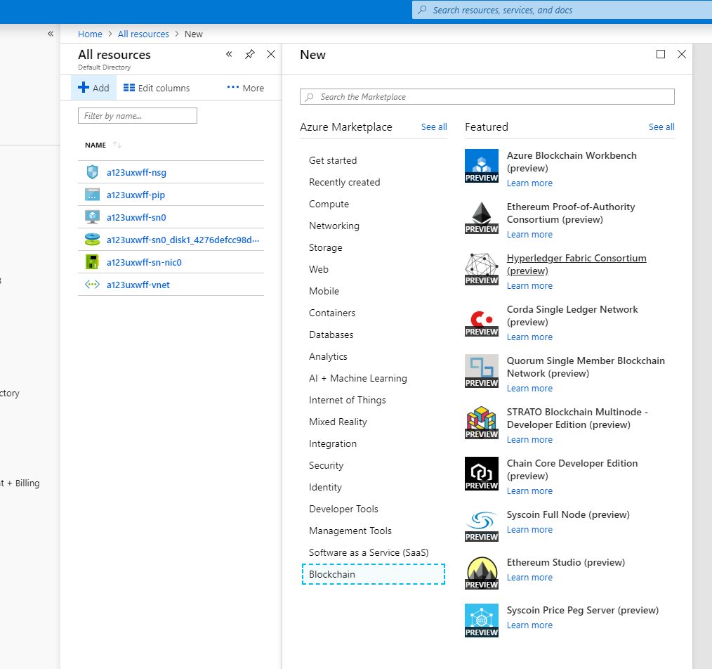

Slide 31
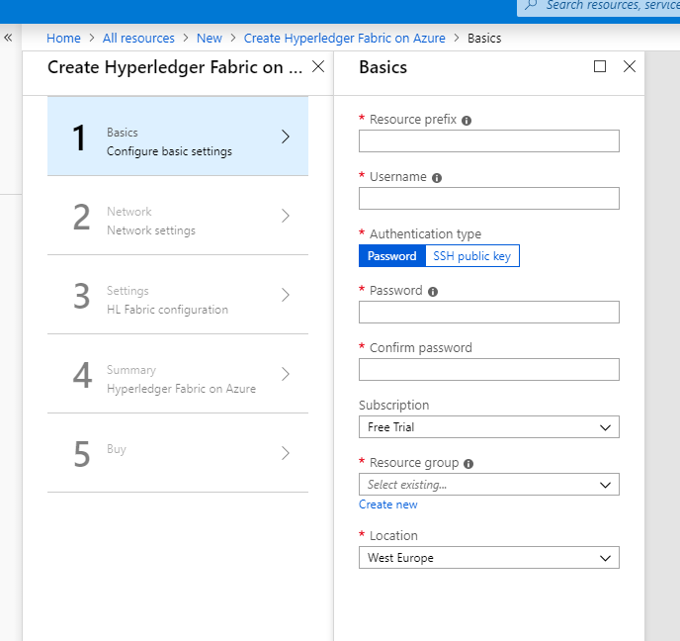

Slide 32
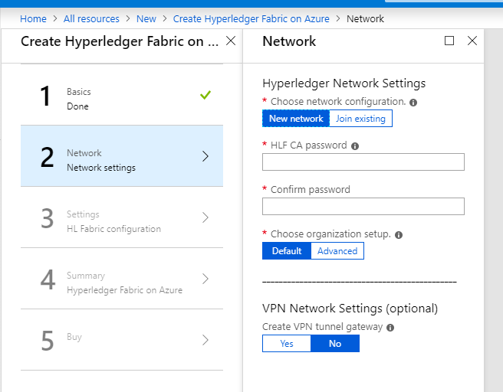

Slide 33
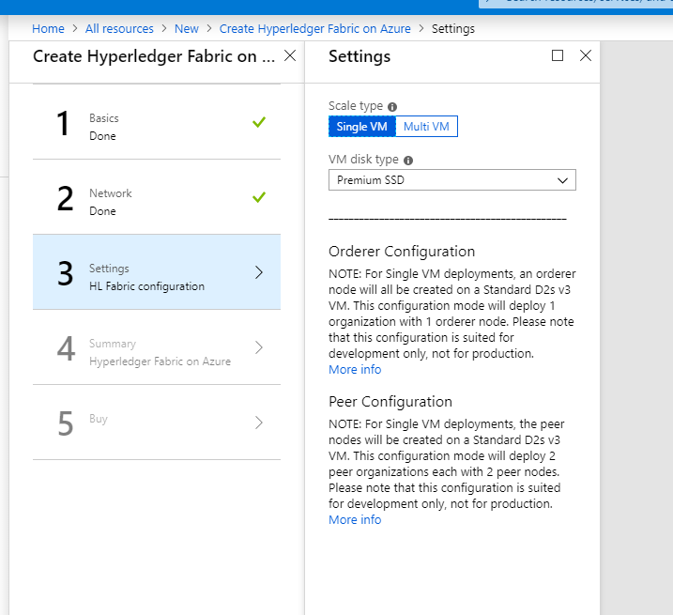

Slide 34
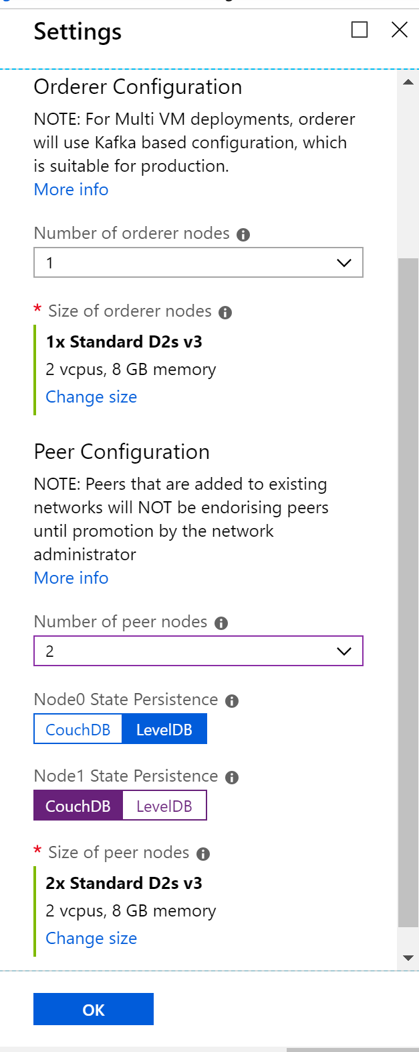

Slide 35
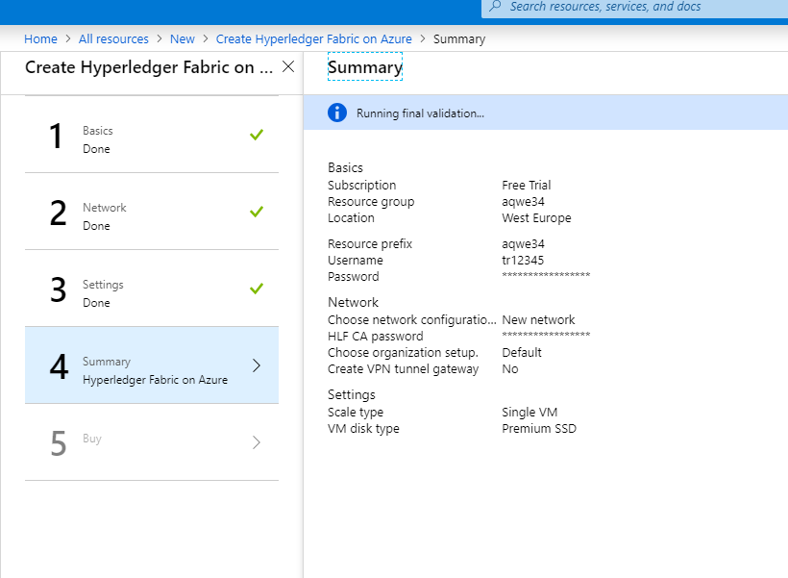

Slide 36
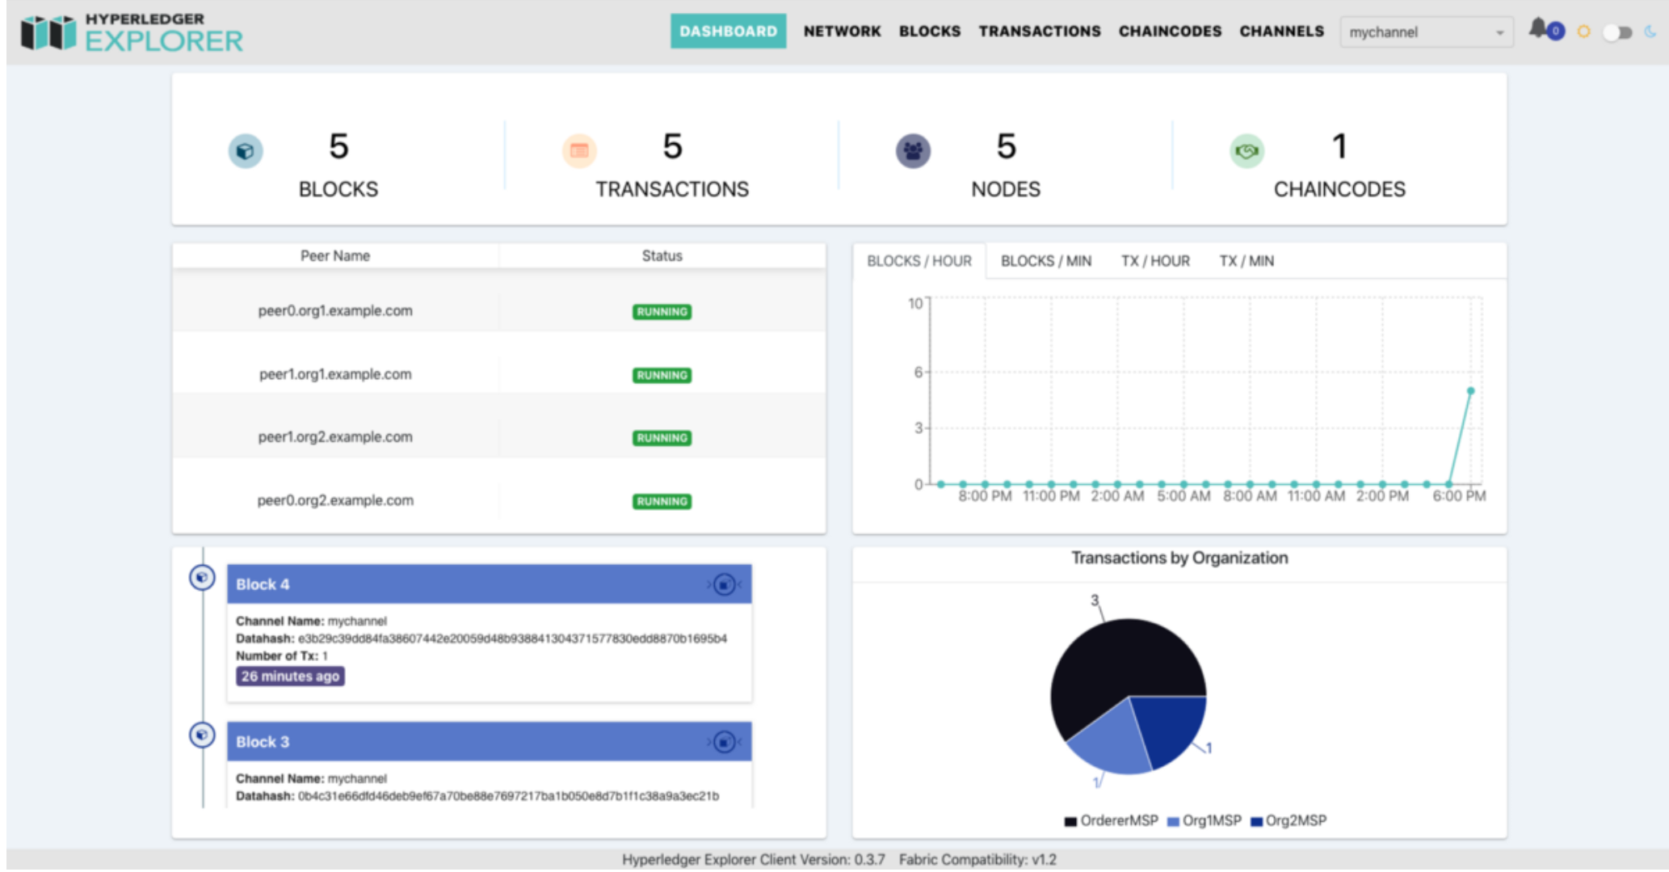
What is next?

Slide 37
Thank you

Slide 38
